Slide 1
Ericsson 3G Optimization
Mohammad Rasoul Tanhatalab
2017

Slide 2
Optimizer Engineer responsibility
·Must have hands-on experience on all major E// monitoring tools, i.e. Business Object, ENIQ, OSS, CTR, GPEH, UEH exception recording, parsing and analysis etc. ·Network capacity dimensioning recommendations ·Able to carry out daily optimization tasks and suggest measures to improve network accessibility and retainability KPI’s like CSSR, CS Drop rate, IRAT, PS drop rate, etc. ·Strong understanding of Ericsson 3G features including the interaction with other technology layers for traffic balancing and best subscriber perception. ·Should be able to perform periodic parameter and feature audits of the network. ·Good understanding and hands on experience of 4G optimization will be a plus. ·Future upcoming features to interact with LTE & how to handle load ·High capacity areas OPTIMIZATION tactics, especially for malls and stadium event ·RACH performance control during high traffic events ·HS/Eul performance options during high # of simultaneous users ·Attractive trials for HS/Eul throughput experience ·Multi-RAB bottlenecks and possible solutions from throughput point of view ·Latency improvement options ·Should have experience to manage own cell & inter-cell interference control ·Power control for HS/EUL associated channels, how it can impact performance ·Speech BLER improvement options ·Channel element dimensioning and optimal utilization, Related features

Slide 3
Problems related to the radio network:
• Dimensioning, Planning, and Architecture
• Hardware Problems
• Uplink (UL) and/or Downlink (DL) Interference
• Handover (HO)/Inter Radio Access Technology (IRAT) HO
• Pilot Pollution
• Idle Mode Parameters
• Resource Allocation (Code, Channel Element, Power, …)
• Admission Control
• Connection Handling
• Power Control
• Security
• Other Cell Parameters

Slide 4
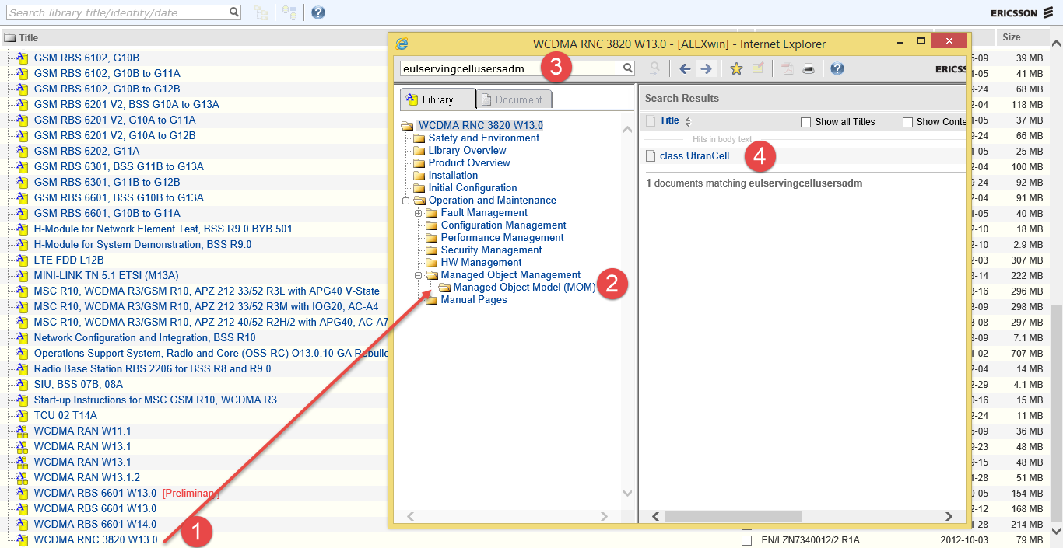
Using ALEX for help

Slide 5
WCDMA RAN Optimization activity
Consistency Check
Parameters
Neighbor definition
Statistics
Alarms
Cell Availability
RRC Establishment
RAB Establishment
CS DCR
PS DCR
RRC Drop Rate
RAB Drop Rate
HO performance
Neighbor Relations
BLER /BER
Throughput

Slide 6
Concept

Slide 7
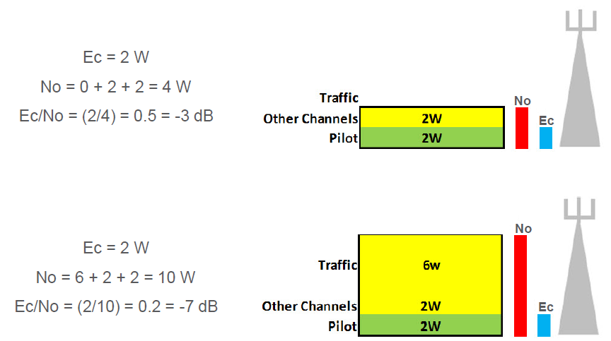
Ec/No, RSCP
Ec/No signifies the level difference between received pilot signal and the overall noise floor.
No is the noise floor, which signifies all the signals (useful and interfering) present at the receiver side.
For example: A value of Ec/No= -8dB tells us that the spread signal is 8 dB below the noise floor
RSCP : Received Signal Code Power is the received power on one code after dispreading, defined on the pilot symbols.
Ec/No = RSCP/RSSI
RSSI It is the combination of all signals received on the downlink frequency ( in FDD mode ) of the WCDMA system. As such it is also referred to as the total noise on the downlink . It is the equivalent of RTWP on the uplink.
RSSI :
Includes all components received. Including the signals from the current and neighbors on the same frequency

Slide 8
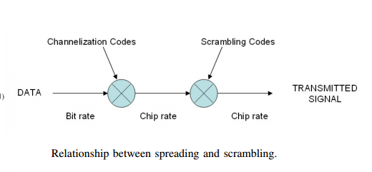

Slide 9
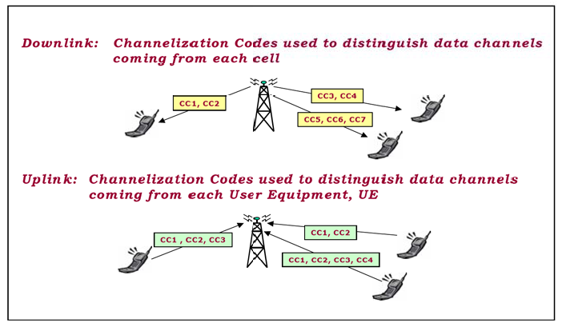
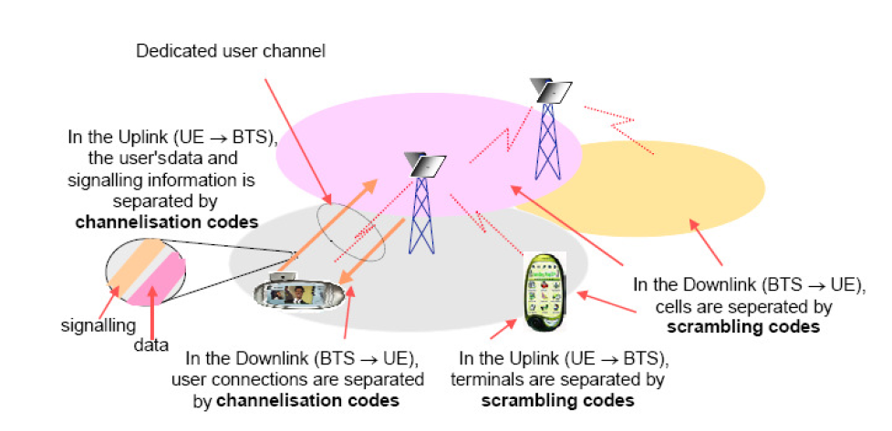
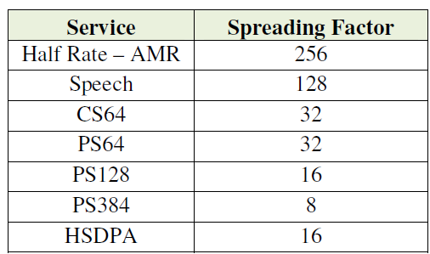
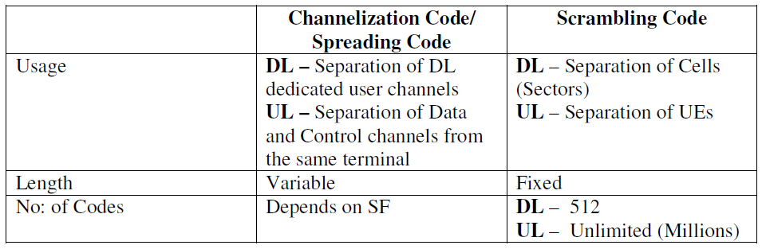
What is the difference between Scrambling, Spreading and Channelization Codes???
Spreading Code = Channelization Code

Slide 10
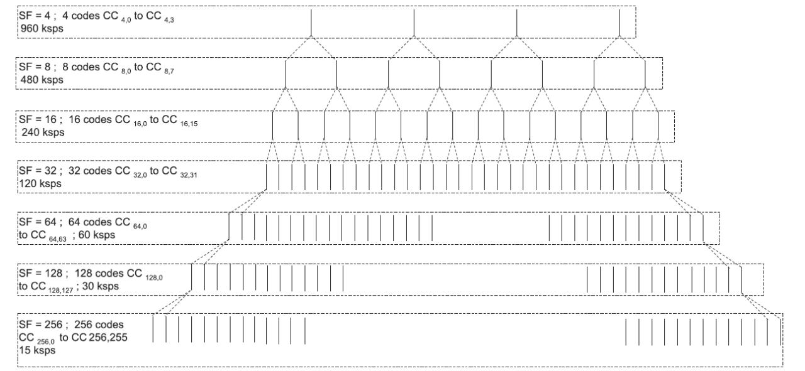
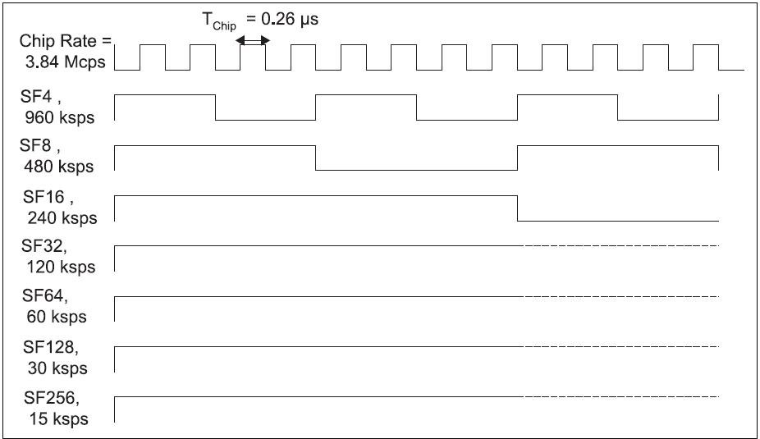
Chip rate is consistence and is 3.84 Mcps then we need the 3.84 MHz

Slide 11
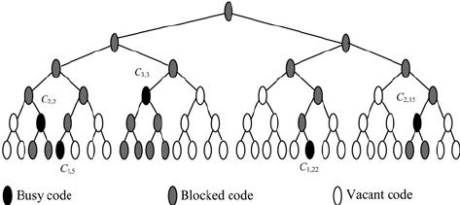

Slide 12
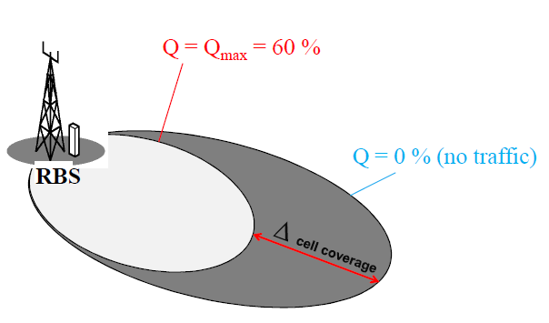
Cell breathing

Slide 13
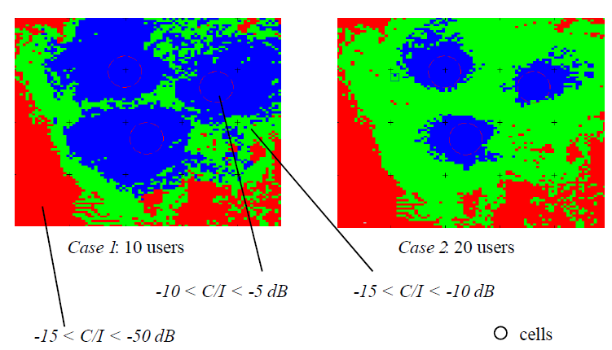
Cell breathing phenomena

Slide 14
Arnell / kaveh /air interface

Slide 15
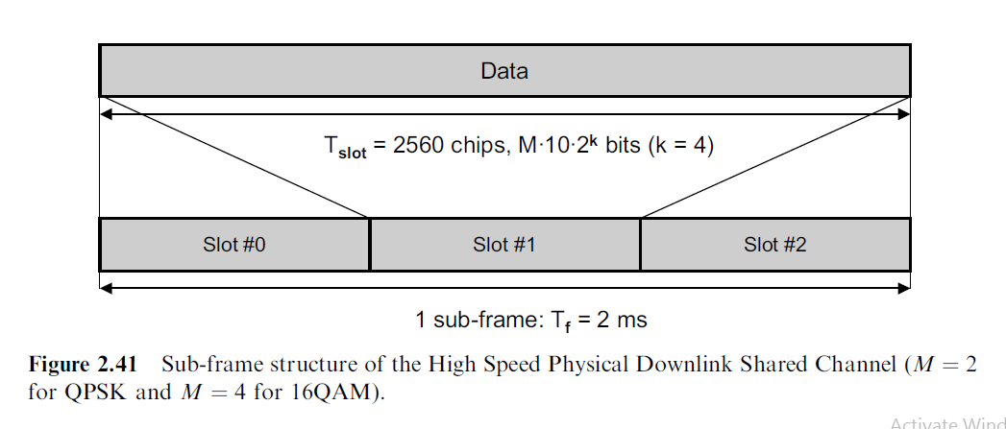
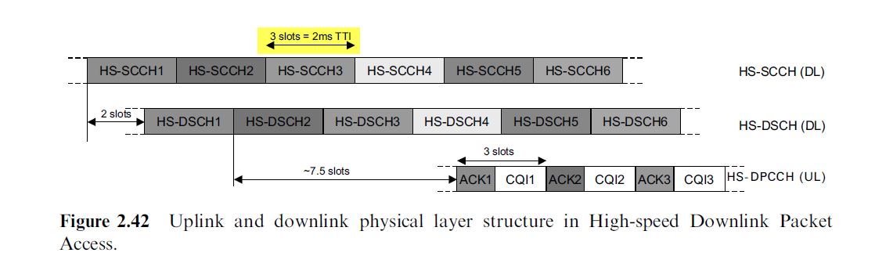

Slide 16
DATA COLLECTION
Performance Statistics are continuously collected from all Network Elements (NE) and stored persistently in Operation Support System, Radio and Core (OSS-RC). Statistics are mainly used for the detection of problem areas and for monitoring the performance of the network on a daily basis. The complete WCDMA Radio Access Network (RAN)Performance Management (PM) functionality receives support
from all WCDMA RAN nodes:
• Radio Base Station (RBS)
• Radio Network Controller (RNC)
• Radio Access Network Aggregator (RANAG – RXI)
• OSS-RC.
The traffic nodes provide the performance information through a file interface. This information is collected by OSS-RC.

Slide 17
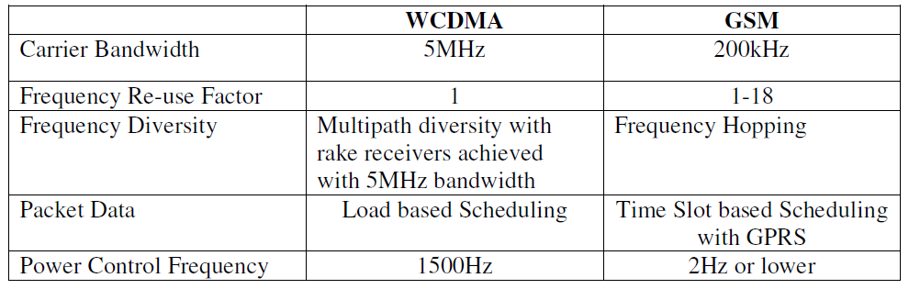
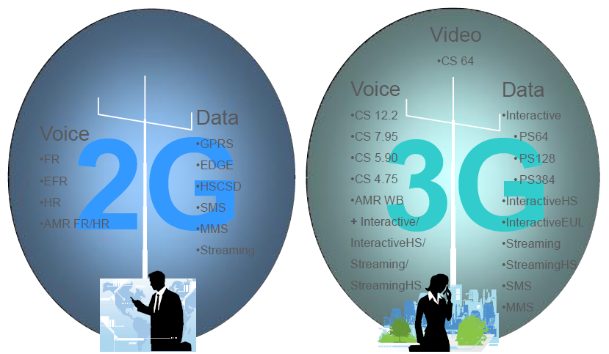
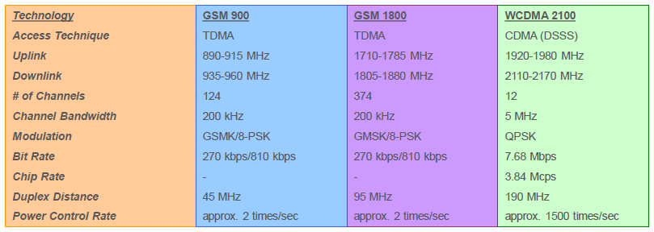
What is the main difference between 3G and 2G?

Slide 18
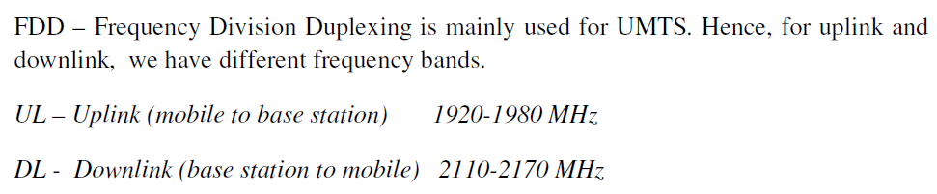
What are the frequency bands used in 3G? Irancell rightell and MCI frequency

Slide 19
Main difference in performance between R99 Packet and HSDPA
R99 Packet service requires dedicated channels whereas HSDPA users have a shared channel
Speeds of HSDPA are much higher compared to 3G(R99). In real networks, an average HS subscriber gets around 5-8 times throughput, compared to an R99 data user. We can easily say that an average HS user can get between 1100kbps to 2000kbps.whereas an average R99 user can get around 250- 280kbps.

Slide 20
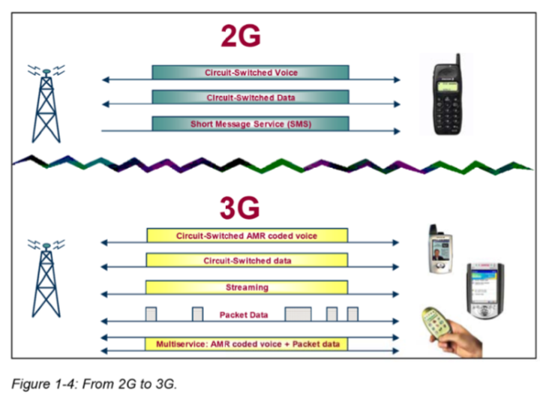
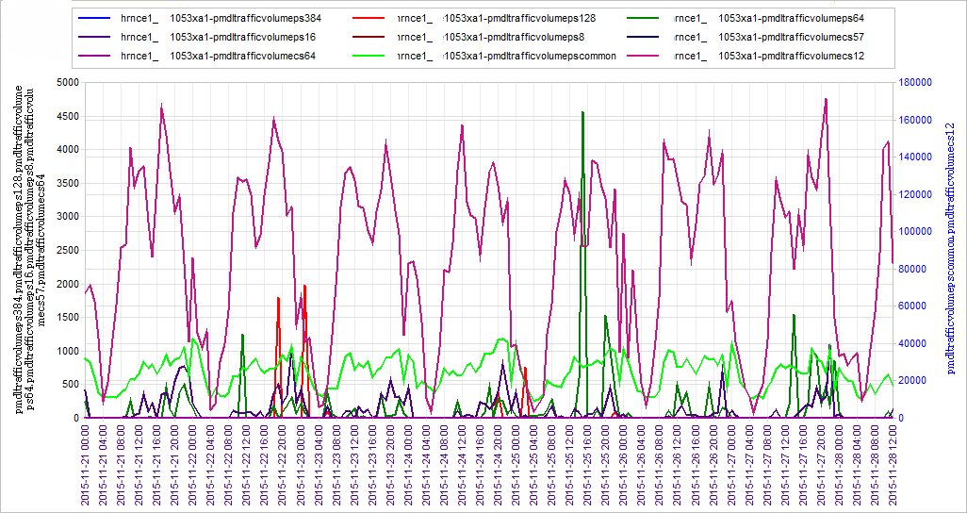
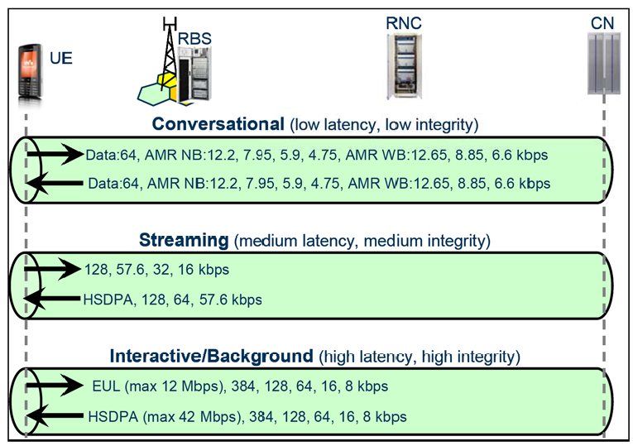
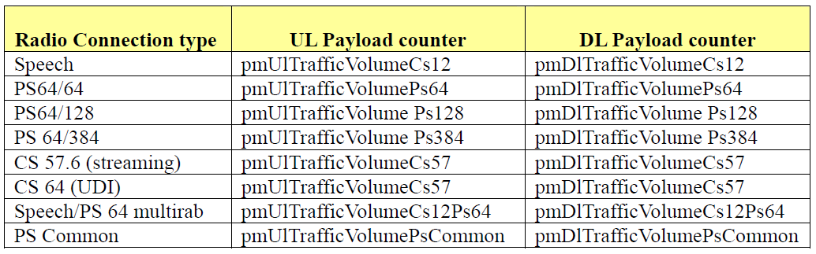
PS and CS traffic
pmDlTrafficVolumePsCommon: Payload traffic in the downlink for the PS RAB on FACH, excluding SRB

Slide 22
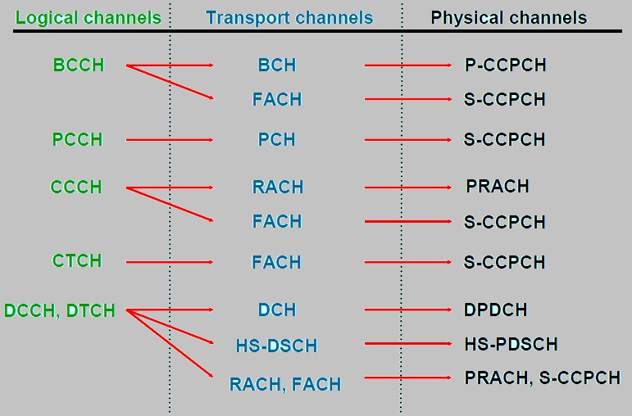
3G Channels

Slide 23
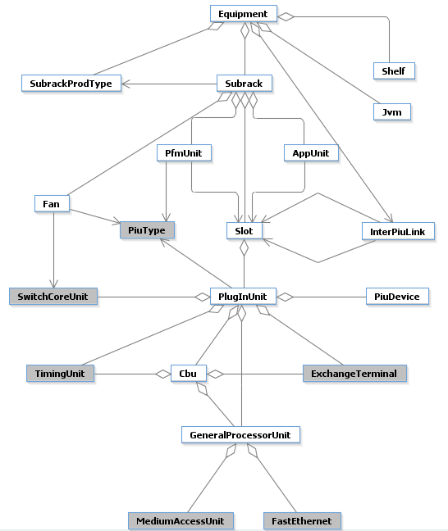
Manage Object Overview
An MO represents a resource in the node, either a physical resource such as a plug-in unit or a logical resource such as a software program or a protocol. In either case, there are parameters associated with the resource, called MO attributes

Slide 24
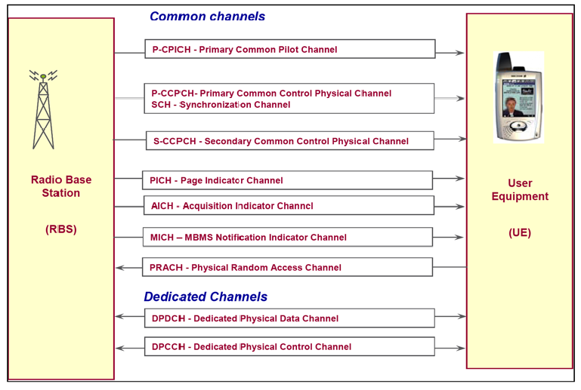
Air interface

Slide 25
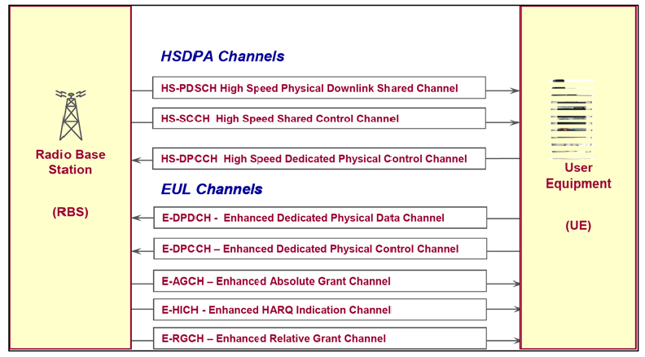
HSPA Air interface

Slide 26
Accessibility: RNC
RRC Setup & Access Rate
RAB Setup & Access Rate
Call Setup Success Rate
PS setup success rate (EUL, HSDPA, R99)
Retainability:
RRC Drop Rate
RAB Drop Rate
PS success rate (EUL, HSDPA, R99)
Mobility:
SHO/ISHO Success Rate
SHO Overhead
HDSPA/HSUPA SCC success rate
Integrity
PS Throughput
HS Throughput

Slide 27
ACCESSIBILITY

Slide 28
Accessibility
The ability of a service to be obtained, within specified tolerances and other given conditions, when requested by the user. It is the percentage of call attempts made by the end-user that are successful. Call setup failures can be blocked calls due to lack of network resources on various levels, for example Transmission Network, Channel Elements, DL Power and so on, or other reason that prevented a successful call setup, for example radio link problem, signaling failure and so on.

Slide 29
ACCESSIBILITY
UE IN IDLE MODE
PLMN SELECTION
CELL SELECTION
LA AND RA UPDATE
PAGING
SYSTEM INFORMATION
RANDOM ACCESS
UL OPEN LOOP POWER CONTROL
RRC CONNECTION SETUP
EMERGENCY CALLS
MODULE MP LOAD
ADMISSION CONTROL BLOCK
LACK OF TRANSMISSION RESOURCES
LOAD SHARING
RADIO LINK SETUP
NAS PROCEDURES
CM SERVICE REJECT
RADIO BEARER SETUP
UE CELL RESELECTION DURING HANDOVER
UE CELL RESELECTION

Slide 30
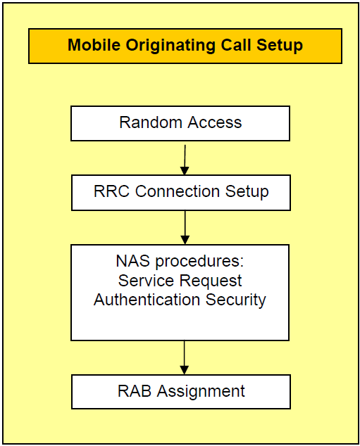
Mobile originating call setup

Slide 31
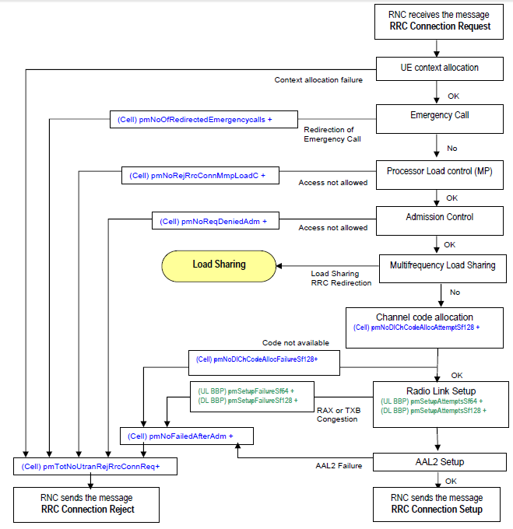
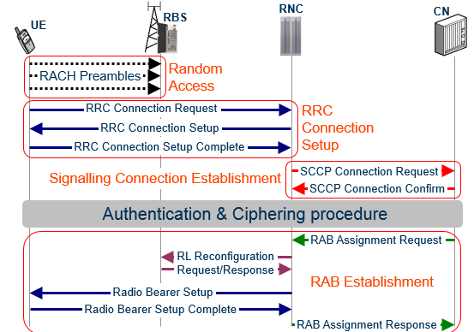
RRC CONNECTION SETUP
AAL2:ATM Adaptation Layer type 2 ??

Slide 32
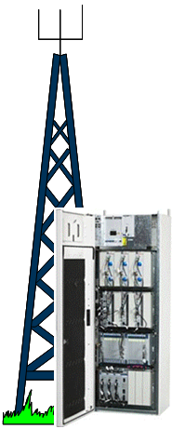
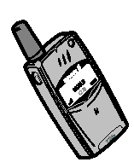
Random Access Procedure
Dedicated channel at just enough power
Connection established with minimum interference to other users
UE 1
1) UE2 measures Pilot channel
3) preamble at calculated power
2) UE2 Reads interference level from Broadcast channel
The power is ramped up until a response is heard or maximum number of re-attempts is reached
UE 2
RBS
Notes:
Click 1 : UE 2 appears
Click 2: UE 2 measures Pilot
Click 3: UE 2 reads interference level from broadcast
Click 4: UE 2 transmits at calculated power
Click 5: The power is ramped up until a response is heard
Click 6: Text ‘Connection established with minimum interference to others’ appears

Slide 33
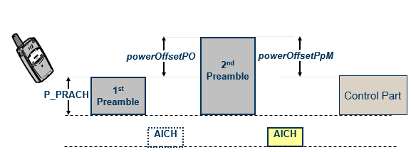
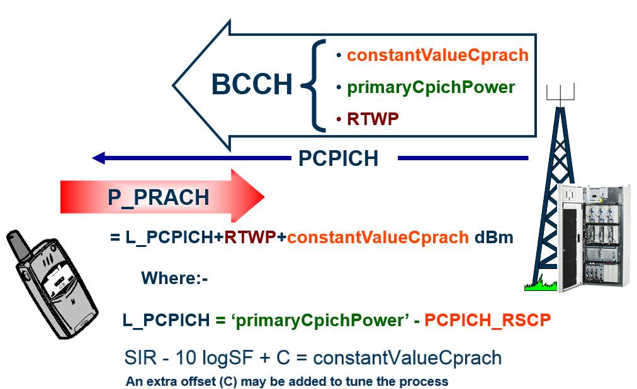
Random Access Parameters
The Random Access Procedure is utilized by the UE to access the UTRAN network from an Idle, or Cell_FACH state
Check RACH parameters to look for a wrong setting:
aichPower
powerOffsetP0
powerOffsetPpm
preambleRetransMax
maxPreambleCycle
constantValueCprach
maxTxPowerUl

Slide 34
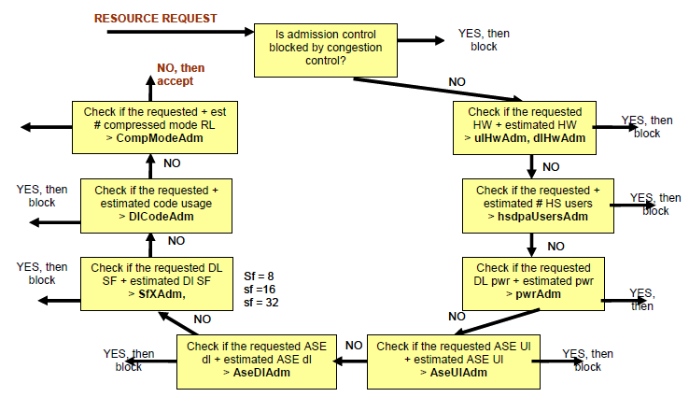
Admission control
Admission control is used in both the uplink and downlink. The admission decision is based on air interface load, by using measurements of uplink interference, downlink output power as well as the actual number of users.
There are nine admission policies to control the blocking.
UL ASE
DL ASE
DL TX cell power
spreading factor usage
code usage
HW usage
amount of HS users
congestion
number of users in compressed mode

Slide 35
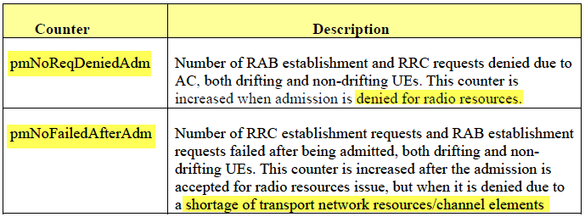
Admission Control has different policies
The counter pmNoReqDeniedAdm shows the number of RRC establishment requests and RAB establishment requests denied for a cell. Please note that this counter is stepped up for RRC establishment, RAB establishment or channel up-switching if admission control triggers the blocking in a cell. The solution to the admission control blocking problem is to check if the admission thresholds (i.e. ulHwAdm, hsdpaUsersAdm , maximumTransmissionPower, aseUlAdmOffset, beMarginAseDl, beMarginAseUl, beMarginDlCode, compModeAdm, dlCodeAdm) match to the original planned capacity. If the thresholds do not match to the original planned capacity, the admission thresholds have to be corrected. Otherwise, re-do the radio network dimensioning to increase the system capacity or activate the inter-frequency load sharing to increase the trucking efficiency.

Slide 36
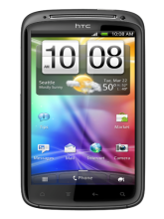
RRC Connection Request/Setup
RRC:RACH/CCCH : RRC Connection Request
RRC:FACH/CCCH : RRC Connection Setup
FACH1 is used to carry control information
Parameter maxFach1Power [-35.0..+15.0] dB
Increasing the power of FACH1 will have higher probability to receive RRC Connection Setup especially in low coverage areas.
Change maxFach1Power from 18 to 38 (1.8 dB → 3.8 dB)
Notes: this setting is not recommended for high capacity cells

Slide 37
Retainability

Slide 38
Retainability
The probability that a service, once obtained, will continue to be provided under given conditions for a given time duration. The percentage of the successfully call setups that were retained during the whole conversation (session) and terminated by the user. The standard KPI for retainability is the Dropped Call Rate. On cell level it is defined as the number of dropped calls in the cell divided by the total number of calls terminated (by end-user or dropped) in the cell.

Slide 39
Integrity

Slide 40
Integrity
The degree to which a service is provided without excessive impairments, once obtained The Service Integrity represents the quality experienced by the user during the call or session. This is very difficult to measure from a system point-of-view and rough measures have to be used, based on RBS and UE measurements. BLER is used as an indication of the service integrity for CS services, but do not show the quality experienced by the end-user. For PS services are BLER and throughput used as service quality indicators.

Slide 41
DT Analysis

Slide 42
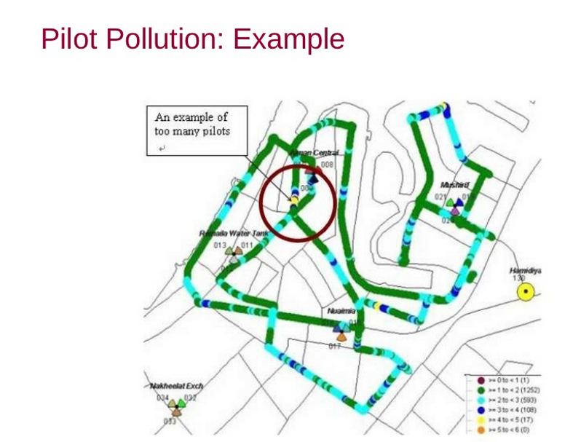

Slide 43
Pilot Pollution
When the number of strong cells exceeds the Active Set Size (How many Cells can be on Soft Handover with a UE), There becomes pilot pollution in the area.
Typically the active set size is 3, so if there are more than 3 strong cells then there is pilot pollution.
Definition of “strong cell”: pilots within the handover window size from the strongest cell. Typical handover window size is between 4 to 6dB. (Depends generally Event1b Removal Range)
For example, if there are more than 2 cells (besides Active Set Cells) within 5dB of the strongest cell then there is pilot pollution.
The UE has the ability to constructively use signals in soft/softer handover, all the other signals received that exceeds the Active Set act as interfering. This interference degrades the performance of the system.

Slide 44
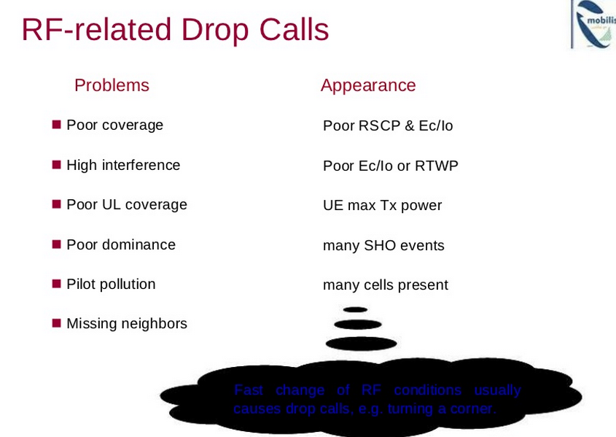

Slide 45
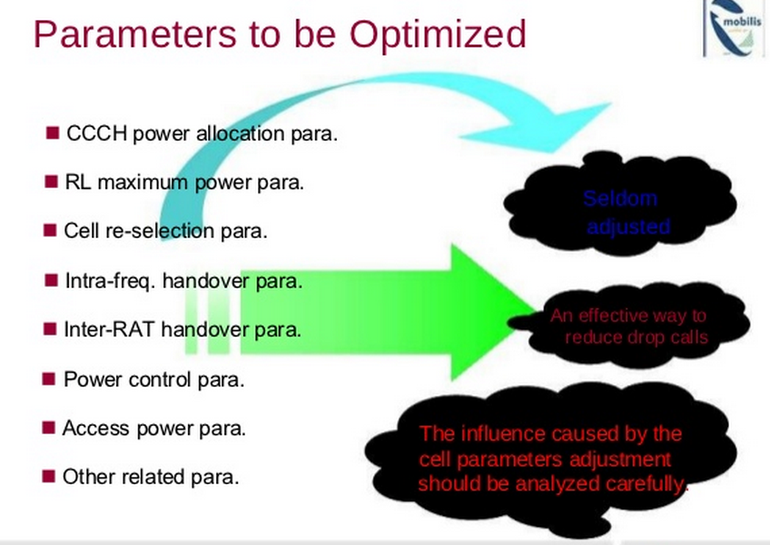

Slide 46
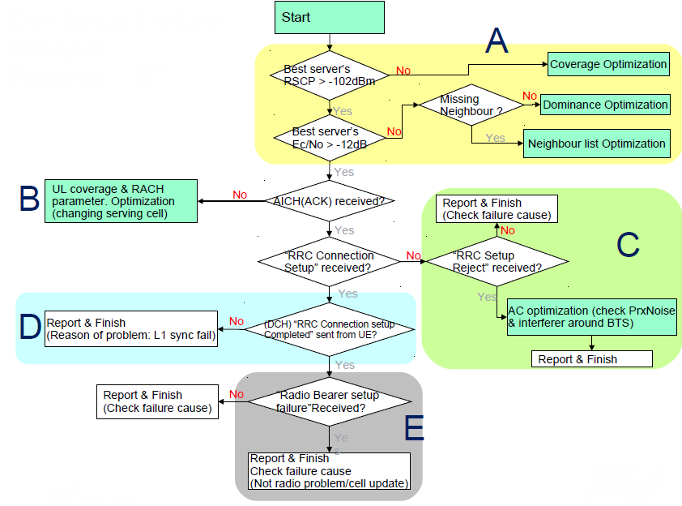
Call Setup Failure Analysis Process__DT

Slide 47
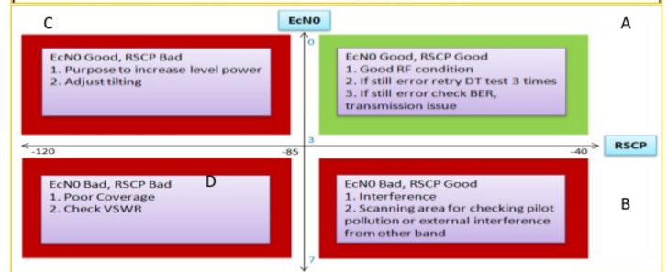
Ec/No and RSCP

Slide 48
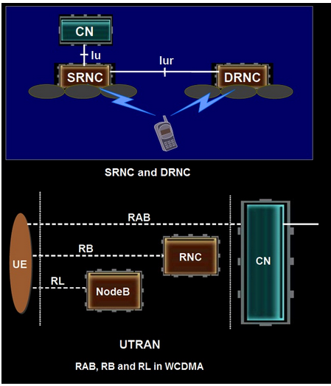
SRNC, DRNC, RAB, RB and RL
SRNC and DRNC
SRNC and DRNC are concepts for a connected UE. The SRNC handles the connection to one UE, and may borrow radio resources of a certain cell from the DRNC.
Drift RNCs support the Serving RNC by providing radio resources A UE in connection state has at least one and only one SRNC, but can has 0 or multiple DRNCs
RAB, RB and RL in WCDMA
RAB: The service that the access stratum provides to the non-access stratum for transfer of user data between User Equipment and CN.
RB: The service provided by the layer2 for transfer of user data between User Equipment and Serving RNC.
RL: A “radio link” is a logical association between single User Equipment and a single UTRAN access point. Its physical realization comprises one or more radio bearer transmissions.

Slide 49
Probability Density Function counters (PDF): A Probability Density Function (PDF) counter is a list of range values. A value is sampled (read) periodically. If the value falls within a certain range, the range counter for that range is increased. All range counter values are collected and stored in a ROP file at the end of each reporting period. For example, if SIR values are split into three ranges: Range1 = [-11 dB – -4 dB], Range2 = [-4 dB – +4 dB], Range3 = (+4 dB – +20dB], and a value is read every 3 minutes over a 15 minute period (values = -10, -3, +5, +5, +6), then the three Range Counters are reported as RangeCounter1 = 1, RangeCounter2 = 1, RangeCounter3 = 3
PEG : A Peg counter is a counter that is increased by one at each occurrence of a specific activity.

Slide 50
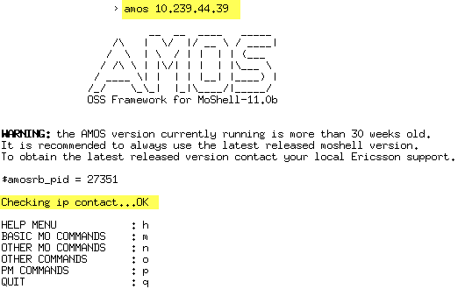
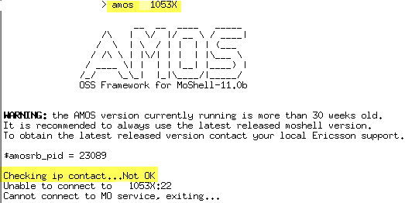
The on-Air site did not define in OSS find by O&M IP

Slide 51
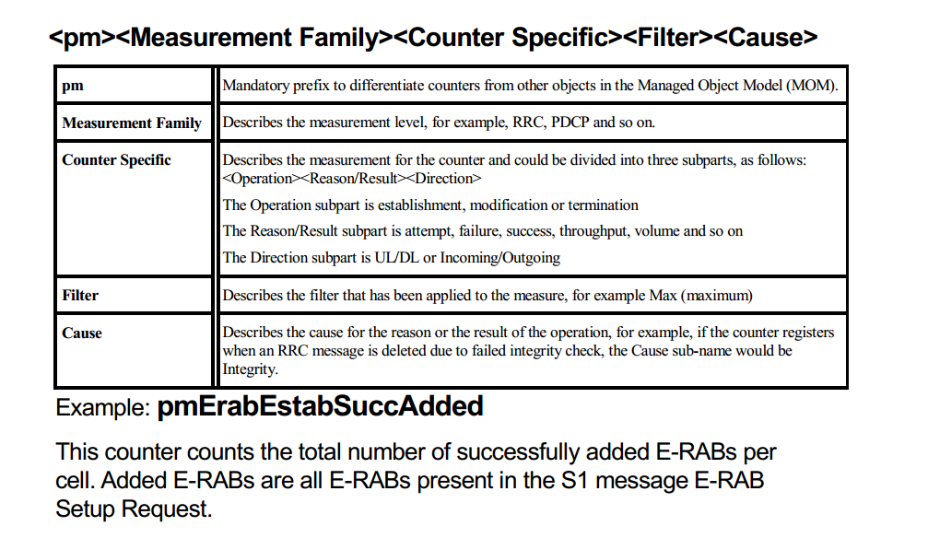
PM prefix

Slide 52
Resources to be monitored
RF Power
Lack of Downlink Power (pmNoFailedRabEstAttemptLackDlPwr)
Code Tree Consumption
Lack of Canalization Code (pmNoFailedRabEstAttemptLackDlChnlCode)
RRC level code
Lack of Canalization Code (pmNoRrcreqdeniedAdmDlChanlCode)
DL and UL ASE
Lack of Downlink ASE (pmNoFailedRabEstAttemptLackDlAse)
Lack of Uplink ASE (pmNoFailedRabEstAttemptLackUlAse)
SF Code Limit (Code Hystogram)
Exceed SF histogram (pmNoFailedRabEstAttemptExceedConnLimit)
HSDPA and EUL connections Limit
UL and DL Channel Elements (CE)
Lack of DL Channel Elements (pmNoFailedRabEstAttemptLackDlHw)
Lack of UL Channel Elements (pmNoFailedRabEstAttemptLackUlHw)

Slide 53
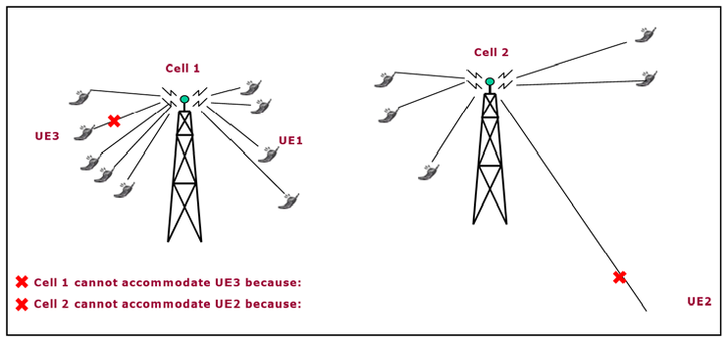
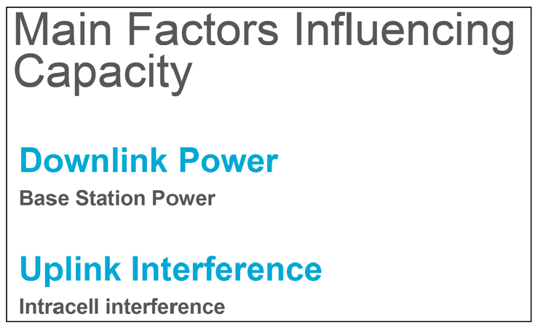
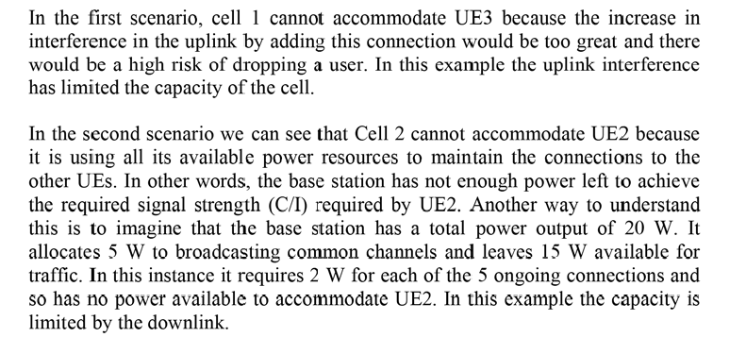

Slide 54
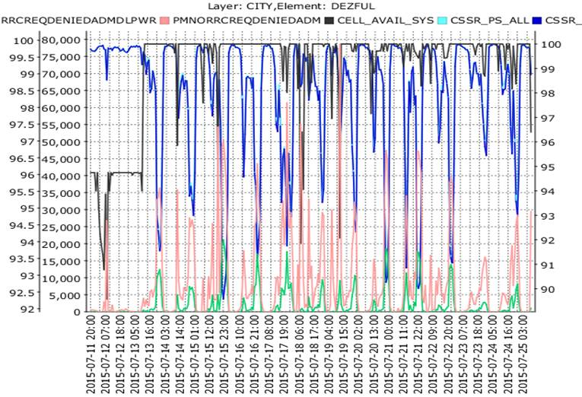
Power Congestion (RRC Denied)
pmNoRrcReqDeniedAdm
Number of RRC requests denied by admission control. The counter is trigged when an RRC connection request with any cause value is denied by Admission Control
pmNoRrcReqDeniedAdmDlPwr
Number of RRC Connection Requests denied by admission control due to lack of DL Power.

Slide 55
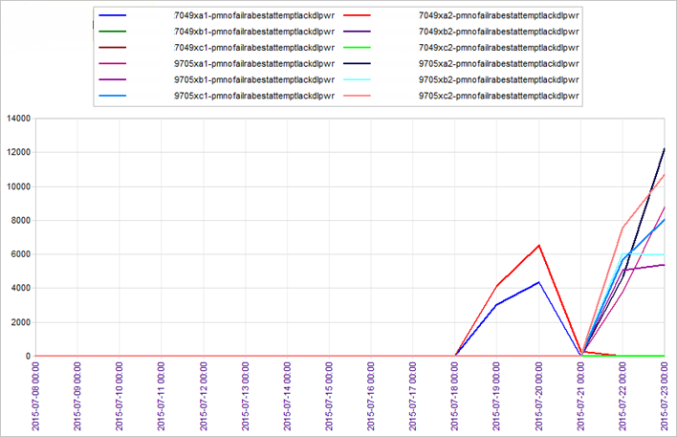
Power Congestion (RAB attempt failed)
pmNoFailedRabEstAttemptLackDlPwr
Number of RAB establishment attempts that failed due to lack of downlink power.

Slide 56

PWR congestion due to locked third carrier configurations

Slide 57

Congestion ?
pmNoOfSwDownNgAdm Number of downswitch requests for non-guaranteed and guaranteed-hs users served by this RNC due to admission control
Condition: Incremented by one when downswitching from Cell_DCH 64/384->64/128 or Cell_DCH 64/128->64/64 initiated by admission control to do Best Effort Cleanup. This is done after an admission rejection due to insufficient downlink power or code utilization limits. The connection to switch down is selected if it is a non-guaranteed and non-drifting connection with a lower spreading factor than that of the latest requested radio link. The counter is incremented in the cell which had to reject admission.

Slide 58
Idle Behavior (2G and 3G)

Slide 59




Parameters QSI (Quality Search Index) and QSC define thresholds and indicate when UTRAN measurements shall be performed (for start of UTRAN FDD measurements in idle mode). QSI is used for idle and packet switched modes and broadcast on BCCH, while QSC is used for active mode, sent on SACCH. It is better to finish the CS call first and then do the IRAT cell reselection.
For (0-6) the UE searches for UTRAN cells if the signal level is below the threshold. For (8-14) for above the threshold
2G Command: rlsup:cell=“cell-name”;

Slide 60

Feature activation in BSC
The feature GSM-UMTS Cell Reselection and Handover is activated per BSC with the exchange property COEXUMTS. COEXUMTS is used to enable the features GSM-UMTS Cell Reselection and Handover, Combined Cell Reselection
Triggering and Combined Handover Triggering GSM to WCDMA. The parameter is a BSC exchange property.
0 OFF ; GSM-UMTS Cell Reselection and Handover and Combined Cell Reselection Triggering GSM to WCDMA are not activated.
1 ON; GSM-UMTS Cell Reselection and Handover is activated.
2 ONADDINFO; GSM-UMTS Cell Reselection and Handover and Combined Cell Reselection Triggering GSM to WCDMA are activated
3 ONADDINFO; GSM-UMTS Cell Reselection and Handover and Combined Handover Triggering GSM to WCDMA are activated
4 ONADDINFO; GSM-UMTS Cell Reselection and Handover, Combined Cell Reselection Triggering GSM to WCDMA and Combined Handover Triggering GSM to WCDMA are activated
BSC Command: raepp:ID=all;

Slide 61
2G to 3G cell reselection based on cell Ranking
The algorithm for cell reselection to UMTS is controlled by the network with the parameters FDDQMIN and FDDQOFF
A Multi-RAT capable UE will reselect a suitable UTRAN cell if the following criteria are fulfilled :
CPICH Ec/No > FDDQMIN &
CPICH RSCP > RLA(s+n) + FDDQOFF
for a period of 5 seconds. (RLA(s+n) = Received Level Average of serving and neighboring GSM cells)

Slide 62

3G CELL SELECTION
The UE bases its evaluation on two quantities: Squal and Srxlev. The cell selection criteria are fulfilled when:
Squal = Qqualmeas- qQualMin > 0
Srxlev = Qrxlevmeas – qRxLevMin – Pcompensation > 0
Where Pcompensation = max(maxTxPowerul – P;0)
qQualmin and qRxLevMin is sent in the broadcast information (SIB 3 for serving cell and SIB 11 for adjacent cells)
maxTxPowerUl is the maximum transmission power during random access on the RACH and that value is sent in the system information (SIB 3).
P is the UE maximum output power according to its class.
The UE measures the received signal Code Power (CPICH RSCP)
and the received quality, on the CPICH (CPICH Ec/No) obtains Srxlev and Srxlev. If both criteria are fulfilled and other requirements for a suitable cell are fulfilled the UE will camp on the cell. The UE will enter
the state “camped normally” where it performs intra-, inter- and
intersystem radio measurements to evaluate if a neighboring cell
is better than the serving one.

Slide 63
CHANNEL SWITCHING

Slide 64

Channel Switching Fundamental
Each channel (FACH/RACH/DCH) requires resources that are “fixed” allocated to that channel (such as DL channelization codes, RBS hardware, RAKE receivers, coding processors etc). Regardless if the channel is used or not the resources allocated to that channel cannot be used by another channel. In the RNC each user has resources allocated but the most limiting resources are the air interface resources (interference/power and the RBS hardware) so it is important to optimize the usage of these as much as possible.
The logical channels, DCCH and DTCH, are mapped onto the DCHs and further onto Dedicated Physical Channels. These physical channels use inner-loop power control.
In the common state the UE is able to transmit control signals and data packets on the common transport channel RACH. The UE also monitors the FACH to receive downlink information. The logical channels, DCCH, CCCH, and DTCH are mapped onto the RACH and the FACH. These channels are suitable for carrying common control information and are shared by all users in the cell. A maximum of 32 kbit/s is available for user data transmission.

Slide 65

WCDMA CHANNEL SWITCHING
Best Effort (BE) users are handled by ‘Channel Switching’ in the WCDMA RAN. Both channel type and channel rate switching are supported. The channel type switching is based on throughput and buffer sizes. The rate switching can be triggered by Admission control, Soft Handover and coverage reasons

Slide 66



WCDMA Channel Switching
There are 8 types of channel switching: 1. Common to Dedicated Evaluation 2. Dedicated to Common Evaluation 3. DCH-DCH Up-Switch Evaluation 4. DCH-DCH Down-Switch Evaluation 5. Common to Idle Evaluation 6. Multi-RAB Up-switch Evaluation 7. Multi-RAB Down-switch Evaluation 8. Down switch: Handover Based
RBS Capacity will calculate with Cell_DCH Users

Slide 67
Cell_DCH State
A dedicated physical channel is allocated to the UE in uplink and downlink.
The UE is known on cell level according to its current active set.
Dedicated transport channels, downlink and uplink (TDD) shared transport
channels, and a combination of these transport channels can be used by the UE.
The Cell_DCH state is entered from the Idle Mode through the setup of an RRC
connection, or by establishing a dedicated physical channel from the Cell_FACH state.
Cell_FACH State
No dedicated physical channel is allocated to the UE.
The UE continuously monitors a FACH in the downlink.
The UE is assigned a default common or shared transport channel in the uplink (RACH or CPCH) that it can use anytime according to the access procedure for that transport channel.
The position of the UE is known by UTRAN on cell level according to the cell where the UE last made a cell update.
Cell_PCH
No dedicated physical channel is allocated to the UE.
The UE uses DRX for monitoring the selected PCH via an associated PICH.
No uplink activity is possible.
The position of the UE is known by UTRAN on cell level according to the cell
where the UE last made a cell update in Cell_FACH state.
URA_PCH
No dedicated channel is allocated to the UE.
No uplink activity is possible.
The location of the UE is known on UTRAN Registration Area (URA) level according to the URA assigned to the UE during the last URA update in Cell_FACH state.
If the network wants to initiate any activity, it needs to make a paging request on the PCCH logical channel within the URA where the location of the UE is known.

Slide 68
Power Control

Slide 69

WCDMA Power Control
Why the WCDMA use Power Control:
Minimize the UL-Interference
Minimize the DL Transmit Power – share resource in WCDMA
Keeping connection quality
Compensating channel destructive effects like attenuation, fading ..
Battery life time improvement in UE

Slide 70

WCDMA Power Control loops working together (UE example)

Slide 71

Power Control

Slide 72

Setting Common Channel Powers

Slide 73

Pilot Channel Power
primary CPICH power should be 8 to 10% (~ 1 Watt) of the nominal RBS power at the reference point (~10W, while MCPA is 20W)
The pilot power is designed to be equal in all cells at the Reference Point.
primaryCpichPower = 30 dBm
TopOfRack = primaryCpichPower + dlAttenuation
System will adjust the TopOfRack to meet the required value.
Consistency check on MaximumTransmissionPowerDL (Calculated vs. setting value)
The feeder loss parameters ulAttenuation & dlAttenuation and electrical delay parameters ulElectricalDelay & dlElectricalDelay must be entered properly in the system (actual VSWR).
More CPICH – less capacity trade off
P-CPICH
dl/ulAttenuation
dl/ElectDelay
TopOfRack
set UtranCell=9546XA primarycpichpower 330
MaxTxPowerDL

Slide 74

??
Carrier maxDlPowerCapability long readOnly,nonPersistent
------------------------------------------------------------------------------------------------------------------------------------
The maximum downlink power capability for the carrier.
Unit: 0.1 dBm
Undefined value: -1
Range: -1 to 500
************************************************************************************************************************************
RbsLocalCell maxDlPowerCapability long readOnly,nonPersistent
------------------------------------------------------------------------------------------------------------------------------------
The maximum downlink power capability for the cell. For a cell using more than one carrier, this value is the maximum DL power capability among the carriers. The attribute value is reported to the RNC.
Unit: 0.1 dBm
Undefined value: -1
Specification: 3GPP TS 25.433, NBAP, UTRAN Iub interface NBAP signalling
Range: -1 to 500

Slide 75

??

Slide 76
CPICH power
Dependencies:
Effect of Change: Change of this parameter effects pilot coverage e.r. handover areas, interference areas, traffic coverage areas. Too low value can lead to appearance of “coverage holes”. Too high value can lead to “near–far” effect or that cell is taking too much traffic. In the loaded co-sited network it can be that some problems we will be solving changing this parameter.
Troubleshooting: This parameter should be investigated when the following problems are observed : Pilot Channel failure due to high downlink interference ( Possible causes: No dominant cell, Dominant interferer, Low best serving EcIo); Pilot Channel failure – out of pilot coverage (Possible causes:Low pilot channel power); Pilot pollution (Possible causes: No dominant cell); Uplink and Coverage pilot imbalance ( Possible causes: Large pilot power, UE in compressed mode); Uneven load distribution (Possible cause: Homogenous pilot setting in an irregular network), Random access procedure problem (Possible cause: PRACH and Pilot coverage imbalance) Handover

Slide 77
Common Control Channel Power
With increasing CPICH power – capacity directly decreasis, but common channels and power per each dedicated channel is calculated from CPICH
At CPICH 30 dBm, the common channel will be configured as follow:
MaximumTransmissionPowerDL is design to be equal with Nominal RBS Power

Slide 78
Common Channel on Downlink

Slide 79
Common Channel on Uplink

Slide 80
Common Channel on Uplink
P_RACH
The initial power on the PRACH - the power of the first preamble - is determined according to equation
P_PRACH = L_PCPICH + RTWP + constantValueCprach (-27dB)
L_PCPICH | : is the path loss estimated by the UE based on knowing the transmitted and received PCPICH power.
RTWP | : is the Received Total Wideband Power (uplink interference) level measured by the RBS.
constantValueCprach | : is used by the UE to calculate the initial power on the PRACH . This parameter is configurable and decides at which level below RTWP preamble ramping will start
Received Total Wideband Power (RTWP)
All transmissions in the uplink contribute to the increase in uplink noise, or Received Total Wideband Power (RTWP). To limit the interference a UE can create, the parameter maxTxPwrUl is used to control the maximum power the UE can transmit. This parameter is typically configured to be 24 dBm for a Class 3 UE.

Slide 81
Common Channel on Uplink
POWER RAMP ON RACH
To reach an appropriate received power level at the RBS, the UE uses preamble ramping. This procedure consists of the following steps:
The UE transmits a preamble.
As soon as the RBS properly detects the preamble, it sends an Acknowledgement Indicator (AI) on the AICH.
While not receiving any AI, the UE transmits a new preamble, increasing the transmission power with respect to the previous one by the configurable parameter powerOffsetP0.(3dB)
As soon as the UE receives an AI, it sends the PRACH message part. The power of the control part of the random access message is determined by the power of the last transmitted preamble and by a configurable offset powerOffsetPpm.(- 4dB) The power of the data part of the PRACH message is determined by the gain factors for PRACH, which is included in System Information.

Slide 82

Common Channel on Uplink
POWER RAMP ON RACH
preambleRetransMax (8) parameter determines how many times PRACH preamble can be sent within one preamble ramping cycle (SIB5&6)
maxPreambleCycle (4) defines how many times the PRACH preamble ramping cycle procedure can be repeated before UE MAC reports a failure on RACH transmission to higher layers (SIB5&6)

Slide 83
Common Channel on Uplink
In average coverage conditions the RRC Connection Setup performance can be improved by tuning the open loop power control parameters
These parameters are
preambleRetransMax and & maxPreambleCycle
powerOffsetPpm
powerOffsetP0
L1 ACK / AICH
Downlink
BS
Not detected
MaxTXPowerUl
powerOffsetP0
Initial preamble power
…
…
…
…
powerOffsetPpm
Uplink
MS
Preamble
1
Preamble
2
Message part
Preamble
preambleRetransMax
# PRACH preambles transmitted during one PRACH cycle without receiving AICH response
maxPreambleCycle
# preamble power ramping cycles that can be done before RACH transmission failure is reported

Slide 84

Sharing Power

Slide 85
Major KPIs and Their Counters

Slide 86


Find some KPIs formula which are defined in RNC

Slide 87

CE_Usage_DL

Slide 88

ChSwitching_DL_UpSwitch

Slide 89

ChSwitching_DownSwitch

Slide 90

Adm_Ctrl_Reasons

Slide 91

Adm_Ctrl_Rejections

Slide 92

Adm_RRC

Slide 93

Availability

Slide 94

Cell_Change

Slide 95

Code_Power

Slide 96

Congestion

Slide 97

Congestion_Control

Slide 98

CSSR_CS64

Slide 99

CSSR_PktInt

Slide 100

CSSR_Speech

Slide 101

DCR_CS64

Slide 102

DCR_PktInt

Slide 103

DCR_Speech

Slide 104

DCRULSYNSOHO

Slide 105

Directed_Retry

Slide 106

Failed_After_Admission

Slide 107

Hard_Handovers

Slide 108

HS_EUL PS Drop

Slide 109

IRAT_HO_Inc

Slide 110

IRAT_IN_CS

Slide 111

IRAT_Out_PS

Slide 112

IUB_Limiting_HS

Slide 113

Paging

Slide 114

RRC_Drop_Rate

Slide 115

RRC_Load_Sharing

Slide 116

RRC_Requests

Slide 117

RRC_Success

Slide 118

SF_Usage_DL

Slide 119

SF_Usage_UL

Slide 120

Soft_Handover

Slide 121

Traffic_Volume_DL

Slide 122

UL_BLER

Slide 123

UMTS_Circuit_Traffic

Slide 124

UMTS_Packet_Traffic

Slide 125

Users

Slide 126

Users_AMR

Slide 127
HSPA+ and EUL

Slide 128
HSDPA Physical and Transport Channels
To support HSDPA new Physical channels have been defined:
HS-PDSCH or High Speed Physical Downlink Shared Channel: This is a downlink channel which is both time and code multiplexed.
The channelization codes have a fixed spreading factor, SF = 16.
Multi-code transmissions are allowed that translates to UE being assigned multiple channelization
codes in the same TTI, depending on the UE capability. The same scrambling code sequence
is applied to all the channelization codes that form the single HS-DSCH CCTrCH.
If there are multiple UE's then they may be assigned channelization codes in the same TTI (multiplexing of multiple UE's in the code domain). HS-DPCCH or High Speed Dedicated Physical Control Channel: This is an uplink channel that
carries the Acknowledgements of the packet received on HS-PDSCH and also the CQI (Channel Quality Indication). THE CQI estimates have to be transmitted by the UE every 2.0 ms frame. This information is very important as it ensures reliability and impacts power capacity. HS-SCCH or High Speed Shared Control CHannel: The HS-SCCH is a fixed rate (60 kbps, SF=128) downlink physical channel used to carry downlink signaling related to HS-DSCH transmission. This provides timing and coding information thus allowing the UE to listen to the HS-DSCH at the correct time and using the correct codes to allow successful decoding of UE data.
The main features of the physical channel are as follows:
Fixed Spreading Factor of 16 for HS-DSCH
QPSK and 16 QAM Modulation
Static TTI Length of 3 Time Slots = 2ms
Fixed CRC of 24 bits
Error Correction using 1/3 Turbo Coding
To support HSDPA the following new Transport channels have been defined:HS-DSCH or High Speed Downlink Shared channel: The High Speed Downlink Shared Channel is a downlink transport channel shared by several UEs. The HS-DSCH is associated with one downlink DPCH, and one or several Shared Control Channels (HS-SCCH). The HS-DSCH is transmitted over the entire cell or over only part of the cell using e.g. beam-forming antennas.

Slide 129
HS Characteristics
Spreading Factor in HSDPA is fixed to 16 and it is not adaptive
Multi-code can be allocated to one user, for example 4 channelization codes of SF=16 can be allocated to a user.
Maximum 15 codes can be used in HSDPA
The number of codes used per user depend on reported CQI
Codes allocated to user only when possible to be used
RBS dynamically allocates the codes to the users every 2 ms

Slide 130
HSDPA Multi Code Transmission
SF=1
SF=2
SF=4
SF=8
SF=16
Remaining codes used for signalling
15 x SF16 => 15(3.84X10⁶/16) = 3.6X10⁶ symbols/sec
QPSK (2bits/symbol) => 3.6X10⁶ x 2 = 7.2 Mbps
16QAM (4bits/symbol) => 3.6X10⁶ x 4 = 14.4 Mbps
64QAM (6bits/symbol) => 3.6X10⁶ x 6 = 21.6 Mbps
64QAM (6bits/symbol) => 3.6X10⁶ x 6 x 2 = 43.2 Mbps (MIMO)
Physical rates
Notes:
Shared-channel transmission implies that a certain amount of radio resources of a cell (code space and power) is seen as a common resource that is dynamically shared between users, primarily in the time domain.
In HSDPA, a new DL transport channel is introduced called high speed DL shared channel. The idea is that a part of the total downlink code resource is dynamically shared between a set of packet-data users, primarily in the time domain. The codes are allocated to a user only when they are actually to be used for transmission, which leads to efficient code and power utilization.
In HSDPA, maximum 15 channelization codes with Spreading Factor (SF)= 16 can be used for this new DL channel. In P4, 5 channelization codes are used enabling user data rates up to 4.32 Mbps (the system is capable of enabling 4.32 Mbps).
The main benefit with DL shared channel transmission is to reduce the risk for code-limited capacity. Sharing codes in the code domain, in other words, code multiplexing, is also possible by employing different subsets of the complete channelization code set for different users. The figure shows an example of 4 users sharing the time and code domain (8 codes).
Sharing in the code domain is useful for providing efficient support of small payloads when the transmitted data does not require the full set of HS-DSCH codes configured in the cell. Useful when supporting terminals cannot despread the full set of codes.
Number of codes, which will be used in each cell, is configured or slowly adapted by RNC according to number of resources needed for packet data services on HS channel and other services such as voice. The RBS dynamically allocates the codes to the users every 2 ms.
With the introduction of HS-DSCH, several other benefits of shared-channel transmission can be exploited, as described below.

Slide 131

HSDPA Scheduling
2 msec TTI
Scheduling Algorithm
EQUAL_RATE [5]
MAXIMUM_CQI [4]
PROPORTIONAL_FAIR_HIGH [3]
PROPORTIONAL_FAIR_LOW [2]
PROPORTIONAL_FAIR_MEDUM [1]
ROUND_ROBIN [0]
HSDPA codes
User #1
User #2
User #3
User #4
Multi-code transmission, UE is assigned to multiple codes in the same TTI
Multiple UEs may be assigned channelization codes in the same TTI
HSDPA shared channel: - shared in time (2 msec TTI) - codes shared between users (4 users per TTI)

Slide 132
numHsScchCodes
The parameter numHsScchCodes controls the number of HS-SCCH broadcast per cell. The number of HS users that can be simultaneously allocated resources by the scheduler per 2 ms Transport Time Interval (TTI) is directly related to the number of HS-SCCH broadcast (maximum is 4).
If a cell has a high HS traffic load, and a low DCH load, it may be beneficial to increase the number of broadcast HS-SCCH. However, if the overall cell throughput is limited due to power, HS-PDSCH codes or transport limitations, consuming another 128 bit code to support an additional HS-SCCH is unneeded.

Slide 133

# Users Per Cell

Slide 134

HSDPA throughput meets theory

Slide 135


R99 Channels Vs. HSDPA

Slide 136
HSDPA Channels
HS-PDSCH
Carries the data traffic 
Fixed SF = 16; up to 15 parallel channels
QPSK: 480 kbps/code, 16QAM: 960 kbps/code
HS-SCCH 
Signals the configuration to be used next: HS-PDSCH codes, modulation format, TB information 
Fixed SF = 128
Sent two slots (~1.3msec) in advance of HS-PDSCH
HS-DPCCH
Feedbacks ACK/NACK and channel quality information (CQI) 
Fixed SF = 256, code multiplexed to UL DPCCH
Feedback sent ~5msec after received data

Slide 137


Slide 138
3G Resources

Slide 139
Ericsson UMTS Feature Guidelines (p 145)
The term channel element (CE) is used to quantify processing power in the Node B chipset. The number of channel elements available for users is dependant on hardware configuration, and number of licensed channel elements enabled. In general, channel elements for the common and overhead channels are included with the Node B, and do not take from the pool of licensed channel elements. In the Ericsson Node B, channel elements for uplink are located on the Random Access and Receiver (RAX) board. The total number of CE available is dependant on the type of RAX board, as well as the number of RAX boards that are installed in the Node B. As an example, the high capacity 3206 RBS can contain 8 RAX R2 boards with 128 channel element each, for a total of 1024 channel elements. The channel elements for the downlink are located on the transmitter card. The total number of CE available is dependant on the number of transmitter boards installed. The 3206 RBS can be configured with 2 transmitter cards with 256 channel elements each, for a total of 512 channel elements.
The number of channel elements utilized by a UE is dependant on several factors. This includes the RAB type used, as well as the soft/softer handover state of the UE. Table 5 provides some examples of downlink and uplink CE usage based on RAB type. As the table shows, RABs with high data rates require additional processing and therefore more channel elements. When a UE is in soft handover, the CE requirement obviously increases since multiple Node Bs are involved. However, when a UE is in softer handover, the same CE will process the multiple radio links within the same Node B.

Slide 140

Channel element allocation for EUL
Traffic on the HS-DSCH will not consume channel elements. However, every HSDPA connection will require A-DCHs for UL/DL signaling and UL traffic. A‑DCHs are dedicated channels, which consume channel elements. Dimensioning of DL resources for A-DCH is not needed since DL A-DCHs do not consume resources from the normal pool of SW licensed channel elements. However, resources for UL A-DCH have to be considered since they consume channels elements from the normal SW licensed pool.
Figure shows that if the R99 traffic load is low in the RBS the EUL scheduler will have more channel elements to share between the EUL users. The EUL users will thus have a higher probability of being scheduled to high rates at low R99 traffic. If R99 traffic load increases, channel elements will be removed from the EUL domain and EUL users will be scheduled to lower rates.
The maximum number of channel elements that can be allocated by E-DCHs can not be higher than the EUL license, even if there are channel elements available in the SW licensed pool.

Slide 141


OVSF and CE Consumption for DL DCH service
OVSF and CE Consumption for UL DCH service

Slide 142



OVSF and CE Consumption for HSUPA
OVSF Code Usage

Slide 143


CE (Channel Element)
Congestion in CE (Channel Element) in Uplink is called Uplink CE Congestion. In 3G network mostly CE congestion observed in Uplink Direction.
Lack of channel elements could be due to insufficient UL (RAX board) or DL (TX board) hardware capacity. Channel element capacity could be also software limited. Admission control is restricted by ulHwAdm and dlHwAdm parameters. They should be set at 100% so no hardware is limited for RRC/RAB setup.
The INVL command help us to see the CE
Congestion at RAX or TX could be indicated by RBS counters pmUlCredits and pmDlCredits respectively.

Slide 144

CE Congestion Causes and Solutions
Causes:
Shortage of License.
Neighbor site down
Overshooting
High number of AC block events on LackDlHw would indicate issues with TX board and LackUlHw would indicate issues with RAX board. Congestion at RAX or TX could be indicated by RBS counters pmUlCredits and pmDlCredits respectively. Congestion per spreading factor (SF) can be also measured using pmSetupFailureSfXX RBS counters from the BasebandPool (BBP) on the uplink (UL BBP) and the downlink (DL BBP).
Solutions for CE Congestion:
Upgrade the CE license according to your vendor.
R99 services uses more CE so try to reduce R99 services. There are several parameters which can help R99 Service utilization optimization.
Load Balancing between 2G and 3G or 3G and 4G can also help to reduce Uplink CE Congestion.
Decrease the Max Bit Rate
Reduce Initial bit Rate from 64 to 32kbs
Enable the DCCC Algorithm
Check that ulHwAdm and dlHwAdm parameters are set to 100% Check numHsResources, numEulResources at the node B (long term solution) Reduce value of sf8Adm to 0 (short term solution) Check for hardware failures on RAX and TXB boards and given the case, order its replacement. Order an additional new RAX or TXB board, depending on the specific case.
Reduce the eulServingCellUsersAdmTti2 value.

Slide 145


Low soft handover success rate due to UL HW congestion
The SHO handover success rate in a RNC degraded mainly due to a site encounter the UL HW congestion. But it has been taken care of after UL CE license upgrade.

Slide 146

ASE (Air-interface Speech Equivalent)
ASE of a radio link = relative value, defined as the air interface load relative to a speech radio link (12.2kbps, 50% activity). A radio link with an ASE of 3 in DL, is expected to generate as much interference in downlink as 3 speech radio links in the cell. General method of estimating ASE value for a specific service

Slide 147

ASE Value per Radio link

Slide 148

Code Tree Consumption Lack of Canalization Code (pmNoFailedRabEstAttemptLackDlChnlCode)
Note: The code tree consumption is measured in percentage of the total tree size by excluding the fixed codes allocated for HSDPA (i.e. the higher the number of codes allocated for HSDPA the smaller will be the available tree and higher the relative consumption).
The admission limit is set by dlCodeAdm (as a percentage).

Slide 149
Logs Handling
RNCSM02> h lg
*******************************************************
lg[aevsyuoldhmircfx] [-l <logdirectory|logfile>] [-m <minustime>] [-p <plustime>] [-s <startdate>] [-e <enddate>] [|<unixcmds>]
*******************************************************
Fetching and/or processing of node logs (alarm, event, availability, system, etc)
Options:
********
- a: parse alarm log (CELLO_ALARM_LOG.xml)
- e: parse event log (CELLO_EVENT_LOG.xml)
- v: parse availability log (CELLO_AVAILABILITY_LOG.xml)
- s: parse system log (/c/logfiles/systemlog/xxxsyslog)
- u: parse upgrade log (Trace.log and Trace.log_old)
- o: parse command log (CORBA_AUDITTRAIL_LOG.xml)
- y: parse securityevent log (CELLO_SECURITYEVENT_LOG.xml).
- l: parse coli log (SHELL_AUDITTRAIL_LOG.xml).
- h: parse hili log (CELLO_HWINVENTORY_LOG.xml). This file must first be generated with the command "hili mk".
- d: show node restarts and system downtime, based upon info of the system log and availability log.
- x: show alarms active on a specific date/time, based upon info of the alarm log.
- m: merge the different logs together (eg: lgaevm will merge alarm/event/availability logs). Not supported with "h" option.
- i: inverse chronological order.
- r: refetch the logs from the node.
- c: print the output in csv format (semicolon separation).
- f: fetch the logs only and store them in a directory on the workstation.

Slide 150
Handover

Slide 151
WCDMA RAN HO Entities
Soft/Softer Handover Execution (SHO_Eval)
Inter-Frequency Handover Execution (IFHO_Eval)
Inter-RAT Handover Execution (IRATHO_Eval)
Inter-RAT Cell Change Execution (IRATCC_Eval)
CN-HHO Execution (CN-HHO_Eval = Hard Handover via Core Network evaluation algorithm)
HS-DSCH Cell Change Execution (HSCC_Eval = Serving HS-DSCH [High Speed Downlink Shared Channel] Cell Change evaluation algorithm)

Slide 152

Entities Involved in Reporting, Evaluation, and Execution of Handover-Related Functions
Soft/Softer Handover, Inter-Frequency Handover, Inter-RAT Handover (including the particular case of Service Based Handover), Inter-RAT Cell Change, Hard Handover via Core Network, and serving HS-DSCH Cell Change all consist of an evaluation part and an execution part. The evaluation part initiates and evaluates UE measurements on neighbor cells. The execution part, triggered by the evaluation results, allocates resources (if necessary) and performs the actual Handover (including serving HS-DSCH Cell Change) or Inter-RAT Cell Change.
UEs are configured to evaluate and send measurement reports to the system only when certain events occur.

Slide 153
UE Associated Cell sets for Measurement
Active Set The cells involved in soft handover and measured by the UE
Virtual Active Set The Active Set associated with a non-used frequency for support of Inter-Frequency evaluation
Monitored Set The cells only measured by the UE and not part of the Active Set. The monitored set can consist of intra-frequency, Inter-Frequency and Inter-RAT cells or list of (neighboring) cells whose pilot channel Ec/Io is continuously measured but not strong enough to be added to the active set.
Detected Set The intra frequency cells (P-CPICH scrambling codes) detected by the UE and they are not in relation definition.

Slide 154
Monitored Set Creation
After the UE has entered state CELL_DCH or after the Active Set is updated (including successful IFHO), the Monitored Set is created. It is based on the neighbor cells of the cells in the Active Set and is typically updated when the Active Set is updated.
The Monitored Set consists of three subsets namely
IAF Monitored Subset
IEF Monitored Subset
GSM Monitored Subset

Slide 155
Measurement Handling (Meas_Handl)
The Measurement Handling algorithm prepares a list of cells that the UE will measure on. The algorithm prepares a message to send to the UE containing the measurement criteria, as well as the list of cells to measure on, in accordance with the handover parameters defined by the operator and the cells currently used in the active set
The number of Intra-frequency cells in the Monitored Set + the Active Set cells is limited by 3GPP to 32.
The number of Inter-Frequency cells in the Monitored set is limited to 32.
The number of Inter-RAT cells in the Monitored set is limited to 32.

Slide 156

Overview of Sets and Subsets of Cells

Slide 157
Overall Process
Initiation
UE Measurements / Evaluation
Measurements
Filtering, Offsetting, Weighting
Evaluation
Reporting
RNC Evaluation
Execution

Slide 158
Types of WCDMA Handover
There can be various types of WCDMA handover as follows:
Soft & Softer handover
3G-2G IRAT handover
2G-3G IRAT handover
Inter Frequency handover
Load sharing

Slide 159

Soft & Softer handover
In Soft Handover the UE is connected to more than one RBS simultaneously. Soft Handover is possible and
necessary with a frequency re-use of one. At least one radio link is always active and there is no
interruption in the dataflow during the actual handover. The signals are received in the UE and combined
in the RAKE receiver to give protection against fading.
In Softer Handover the UE communicates with one RBS through several radio links. The Softer Handover
is a handover between two or more cells of the same RBS.
In addition to this code limiting effect described above, soft and softer handover also add to the consumption of OVSF codes. Assuming that the average soft handover factor was 1.8 radio links per user, each user would require 1.8 codes on an average (excluding the HS-PDSCH).

Slide 160


Soft & Softer handover
In Soft Handover the combining techniques of information from different radio paths are different for uplink and downlink.
In the uplink selective combining is used; the RNC receives transport blocks from different RBSs and chooses the best block according to the CRC.
In the downlink the signals are combined in the Rake receiver in the UE, using MRC
(Maximum Ratio Combing).
In Softer Handover different diversity branches, both in the uplink and downlink, can be combined in the same Rake receiver, hence MRC can be used in both directions.

Slide 161

Handover Events
To enable handovers, the UE is measuring on CPICHs in the active and monitored set, using the searcher finger of the Rake receiver, When a new pilot enters the reporting range an event is triggered. Then the UE sends a report to the RNC for evaluation. When new resources are needed the Soft/Softer Handover Execution checks with Admission Control if they are available, before execution. The UE gets a message to add/replace or remove the new cell and information about the updated monitored set.
UeMeasControl measQuantity1 enumRef:SupportedMeasQuantities
----------------------------------------------------------------------------------------------Used by UE functions for intra-frequency measurements (in CELL_DCH). Quantity to measure for the chosen mode. The value of this attribute will set the message data CPICH_Ec/No or CPICH_RSCP accordingly.
Dependencies: If CN Hard Handover is supported and measQuantity1 is changed, (the measurement method is changed), the attribute intraFreqCnhhoPenalty in MO Handover must be correctly set for the new measurement method. The system will not enforce this.
Change takes effect: Ongoing connections (next switch to CELL_DCH)
Default=CPICH_EC_NO
Range: 1,2

Slide 162



Event-1a-Addition of a RL
When a primary CPICH, not included in the Active Set, enters the reporting range, event 1a occurs. The UE sends an event 1a report to the RNC. If the reported cell is a valid neighbor and the Active Set is not full, the cell is proposed as an addition to the Active Set. The event 1a reporting is configurable through the parameter reportingRange1a.
> (reportingRange1a + hysteresis1a/2) for timetotrigger1a duration
Hysteresis1a = 0 = No Hysteresis
Reportingrange1a= 6 = 3 dB
Timetotrigger1a = 9 = 200ms

Slide 163

Event-1b-Removal of a RL
When a primary CPICH, included in the Active Set, leaves the reporting range, event 1b occurs. The UE sends an event 1b report (proposal of Radio Link removal) to the RNC.
If the report includes more than one cell, all cells are proposed by the evaluation to be removed. However, one cell is always kept in the Active Set. The event 1b reporting is configurable through the parameter reportingRange1b.
< (reportingRange1b - hysteresis1b /2) for timetotrigger1b duration
Hysteresis1b = 0 = No Hysteresis
Reportingrange1b= 12 = 6 dB
Timetotrigger1b = 13 = 1280ms

Slide 164


Event-1c-Replacement of a RL
When a primary CPICH, not included in the Active Set, becomes stronger than the weakest CPICH in the Active Set, event 1c occurs. The UE sends an event 1c report to the RNC.
If the reported cell is a valid neighbor and the Active Set is full, the reported cell is proposed as a replacement for the weakest cell in the Active Set. The event 1c reporting is configurable through the parameter hysteresis1c
Hysteresis1c = 2 = 1 dB
Timetotrigger1c = 11 = 320ms

Slide 165


Event-1d-Change of best cell in AS
When any of the primary CPICHs become stronger than the best primary CPICH, event 1d occurs. The UE sends an event 1d report to the RNC.
the reported cell is a valid neighbor and the Active Set is not full, the cell is proposed as an addition to the Active Set. If the Active Set is full, the cell is proposed as a replacement for the weakest cell in the Active Set.
The event 1d reporting is configurable through the parameter hysteresis1d.
Hysteresis1d = 15 = 7.5 dB
Timetotrigger1d = 12 = 640ms

Slide 166
Counters & KPIs related to SHO
pmRlAddAttemptsBestCellSpeech : CS Speech RABs
pmRlAddAttemptsBestCellCsConvers : CS Conversational 64kbps RABs
pmRlAddAttemptsBestCellPacketHigh : high-rate (greater than 64 kbps) PS Interactive RABs
pmRlAddAttemptsBestCellPacketLow : low –rate (less than 64 kbps) PS Interactive RABs
pmRlAddAttemptsBestCellStandAlone : Stand-alone SRB 13.6 connections
pmNoTimesCellFailAddToActSet : Number of times that a cell could not be added to the active set of a UE.
pmSumUesWith1Rls1RlInActSet : Sum of all sample values recorded during a ROP for the number of UEs with one radio link set and one radio link in the active set.
pmSumUesWith1Rls2RlInActSet
pmSumUesWith1Rls3RlInActSet
SHOSuccess = 100 * pmNoTimesRlAddToActSet / (pmNoTimesRlAddToActSet + pmNoTimesCellFailAddToActSet) Accepted range is 99
SHO Overhead = (1* pmSumUesWith1Rls1RlInActSet +2* pmSumUesWith1Rls2RlInActSet +3* pmSumUesWith1Rls3RlInActSet )/(pmSumUesWith1Rls1RlInActSet + pmSumUesWith2Rls1RlInActSet + pmSumUesWith3Rls1RlInActSet)
Accepted range is 1.5

Slide 167


Inter Frequency & Inter RAT Handover
Inter-Frequency handover is only attempted if IfHoAllowed is set to Allowed and FddIfHoSupp is set to On for the current UeRc state.
Inter-RAT handover is only attempted if GsmHoAllowed is set to Allowed and FddGsmHoSupp is set to On for the current UeRc state.
If both Inter-Frequency handover and Inter-RAT handover are allowed and both Inter-Frequency and Inter-RAT neighbors cells exist for the cells in the Active Set, the decision to perform Inter-Frequency or Inter-RAT handover is based on a configurable parameter, hoType, defined per cell
The Inter-frequency or IRAT handover is triggered based on three criteria, Ec/No, RSCP) and UE Tx Power. These events are also used for IRATHO and IRATCC. Based on that Event 2d,2b,2f,3a will occur.

Slide 168

What is compressed mode?
During inter-frequency handover the UE’s must be given time to make the necessary measurements on the different WCDMA carrier frequency. 1 to 7 slots per frame can be allocated for the UE to perform this intra frequency (hard handover). These slots can either be in the middle of the single frame or spread over two frames.
This compressed mode operation can be achieved in three different methods:
Decreasing the spreading factor by 2:1. This will increase the data rate so bits will get sent twice as fast.
Puncturing bits. This will remove various bits from the original data and hence reduce the amount of information that needs to be transmitted.
The higher layer scheduling could also be changed to use less timeslots for user traffic

Slide 169

Inter Frequency Handover-Event 2d,2b,2f
Ran quality of current frequency < (usedFreqThresh2dEcno + serviceOffset2dEcno-hysteresis2d/2) for a duration timetotrigge2d—Event 2d triggers and UE enters the compressed mode.
Ran quality of current frequency > (usedFreqThresh2dEcno + serviceOffset2dEcno-hysteresis2d/2+usedFreqRelThresh2fEcno) for a duration timetotrigge2f—Event 2f triggers and UE exists the compressed mode.

Slide 170

Inter Frequency Handover-Event 6d, 6
The UE is also configured for event trigger decision based on threshold ueTxPowerThresh6b Reporting event 6d and 6b If the UE TX Power reaches maximum, and the condition is maintained during a time not less than timeTrigg6d, then event 6d occurs and Inter-Frequency or GSM/GPRS measurements need to be performed by UE. If the UE TX Power goes below ueTxPowerThresh6b threshold, and the condition is maintained during a time not less than timeTrigg6b, then event 6b occurs and the UE is requested to stop measurements on Inter-Frequency GSM/GPRS cells.

Slide 171

Inter Frequency Handover-Sequence
If the measured quality of the best cell in the Active Set on the currently used frequency is below usedFreqTresh2dEcno + usedFreqThresh4_2bEcno, and the quality and RSCP of the measured best cell on unused frequency both are above nonusedFreqThresh4_2bEcno and nonusedFreqThresh4_2bRscp (also taking the hyst4_2b into account), the UE sends a measurement report after timeTrigg4_2b to the SRNC to perform the handover.

Slide 172
Inter Frequency parameters
usedFreqThresh2dRscp = -102 (Cell Level)
usedFreqThresh2dEcno = -13 (Cell Level)
Hysteresis2d=0
Hysteresis2f =0
nonUsedFreqThresh4_2bRscp= -95
nonUsedFreqThresh4_2bEcno= -10
timeToTrigger2dEcno=320
timeToTrigger2dRscp=320
timeToTrigger2fEcno=1280
timeToTrigger2fEcno=1280
timeToTrigger6d=320
timeTrigg4_2b=100
timeTrigg6b=1280
ueTxPowerThresh6b=20
usedFreqRelThresh2fEcno=2
usedFreqRelThresh2fRscp=3
usedFreqRelThresh4_2bEcno=-1
usedFreqRelThresh4_2bRscp=-3

Slide 173

Inter RAT Handover-Event 2d,3a,2f
Ran quality of current frequency < (usedFreqThresh2dEcno + serviceOffset2dEcno-hysteresis2d/2) for a duration timetotrigge2d—Event 2d triggers and UE enters the compressed mode.
Ran quality of current frequency > (usedFreqThresh2dEcno + serviceOffset2dEcno+hysteresis2d/2+usedFreqRelThresh2fEcno) for a duration timetotrigge2f—Event 2f triggers and UE exists the compressed mode.

Slide 174
Inter RAT Handover-Event 2d,3a,2f
estimated quality of the currently used radio link < usedFreqTresh2dEcno - utranRelThresh3aEcno – Hysteresis3a/2
estimated quality of the target GSM cell > gsmThresh3a+Hysteresis3a/2 for a time duration timetotrigger3a

Slide 175

Inter RAT Handover-Event 2d,3a,2f

Slide 176

Inter RAT Cell Change-Event 2d,3a,2f

Slide 177
IRAT parameters
usedFreqThresh2dRscp = -102 (Cell Level)
usedFreqThresh2dEcno = -13 (Cell Level)
Hysteresis2d=0
Hysteresis2f =0
timeToTrigger2dEcno=320
timeToTrigger2dRscp=320
timeToTrigger2fEcno=1280
timeToTrigger2fEcno=1280
timeToTrigger6d=320
usedFreqRelThresh2fEcno=2
usedFreqRelThresh2fRscp=3
Hysteresis3a=0
timeToTrigger3a=6
utranRelThresh3aEcno=0
utranRelThresh3aRscp=-5
measQuantity1= 2 (CPICH_EC_NO)

Slide 178

Inter Handover 2G-3G
Triggering will be based on QSC settings when to start WCDMA measurements. The 2G-3G neighbor list has
to be defined for every cell in BSC which will be broadcasted on the SACCH. This list can be the same as the
list broadcast on BCCH to Multi-RAT MSs in idle mode, but it is also possible to set it separately in order to
have different UMTS neighbors in idle and active mode.
The Multi-RAT mobile is informed of how many UMTS cells (0-3) shall be reported in the measurement
report. This is set by parameter FDDMRR. The remaining positions will be used for GSM cells.
2 criteria's must be full filled for a GSM
to UMTS handover to happen.
Percentage of idle TCH in the
serving cell ≤ ISHOLEV
CPICH Ec/No > MRSL

Slide 179
WCDMA Load Sharing Techniques
Load sharing enhances the performance of a Radio Access Network by pooling together resources from different parts of the entire network.
The following load-sharing features are available in the WCDMA RAN:
Inter-Frequency Load Sharing
HS IFLS non HS IFLS
Directed Retry to GSM
Load based HO to GSM
Inter-frequency load based HO
Service based HO

Slide 180

Inter-Frequency Load Sharing-Configuration
This feature is activated in an RNC by setting the parameter loadSharingRrcEnabled to TRUE.
The attribute loadSharingCandidate specifies whether the target cell is a load-sharing neighbor of the source cell.
Possible values for loadSharingCandidate are TRUE and FALSE.
There should be no more than one neighbor per carrier for each source cell, and all load-sharing neighbors should be co-located.
This feature uses the same neighbor-cell relations as Inter-Frequency Handover.
If a relation is created for Load Sharing purpose but not wanted by Inter-Frequency Handover, the handover can be suppressed by setting the cell parameter hoType to NONE or GSM_PREFERRED.

Slide 181


Inter-Frequency Load Sharing-Operation
The amount of resource excluded from load-sharing use is specified by the cell parameter loadSharingMargin as a percentage of pwrAdm.
The performance of Inter-Frequency Load Sharing can be monitored via the following three counters:
• pmTotNoRrcConnectReq gives the total number of RRC connection requests in a cell.
• pmNoLoadSharingRrcConn gives the number of RRC redirections performed for load-sharing reason in a cell.
• pmNoOfReturningRrcConn gives the number of calls that has returned to the original frequency after an RRC-redirection.

Slide 182
HS/Non HS IFLS
IFLS feature will help to sending exceedig traffic in a cell to other carriers in order to balance the number of users and avoid congestion. This feature works for HS and Non HS IFLS when activated at RNC level:
rncfeature hspaloadsharing → TRUE (HS IFLS at RNC level)
rncfeature dchloadsharing → TRUE (Non HS IFLS at RNC level)
In order to use this feature is necessary to create for each cell a coverage relation with all other carriers of the same sector. Next step is configure and activate the feature at coverage relation level:
set UtranCell=WXXX,CoverageRelation=WXXX relationCapability dchLoadSharing=1
set UtranCell=WXXX,CoverageRelation=WXXX relationCapability hsLoadSharing =1
The following initial configuration was used:
hsPathlossThreshold → 120 (coverage relation level) (Pathloss threshold used for both HS IFLS)
pathlossThreshold → 170 (sector level) (A pathloss check is performed before triggering a blind IFHO to a candidate cell, when performing load sharing from DCH state. If the pathloss is high
er than this threshold, the blind IFHO is not allowed.)
hsIflsMarginUsers → 10 (sector level) (Margin for HS interfrequency load sharing, relative to the admission limit hsdpaUsersAdm)
hsIflsThreshUsers → 20 (sector level) (load sharing triggered for source cell)
dchIflsThreshPower -> 0 (power threshold for DCH load sharing)

Slide 183

IFLS (inter Frequencies Load Sharing)
UtranCell hsIflsThreshUsers long
------------------------------------------------------------------------------------------------------------------------------------
Threshold for triggering HS interfrequency load sharing in the source cell, relative to the admission limit hsdpaUsersAdm. If more than hsIflsThreshUsers/100 * hsdpaUsersAdm HS users are present when a RAB transition is being evaluated, load sharing is triggered.
Setting this parameter to 0 disables HS interfrequency load sharing in this cell.
Only used if RncFeature=HspaLoadSharing or RncFeature=IflsRedirectDownswitch (or both) is activated.
Feature: HspaLoadSharing, IflsRedirectDownswitch
Change takes effect: Immediately
Unit: %
Range: 0 to 100, Default=0
UtranCell hsIflsMarginUsers long
------------------------------------------------------------------------------------------------------------------------------------
Margin for HS interfrequency load sharing, relative to the admission limit hsdpaUsersAdm. When calculating remaining free resources in the cell during evaluation of a RAB transition, this margin is subtracted from the result, making the cell look more loaded than it is and therefore making it a less likely target for HS inter-frequency load sharing decisions.
Only used if RncFeature=HspaLoadSharing or RncFeature=IflsRedirectDownswitch (or both) is activated.
Feature: HspaLoadSharing, IflsRedirectDownswitch
Change takes effect: Immediately

Slide 184
CPICH Ecno Thr & iflsMode
The parameter iflsCpichEcnoThresh defines the measured downlink EcNo value above which HS and Non HS IFLS reconfiguration from FACH or URA are allowed. When configured as -24 means that this value is not used and reconfigurations are always allowed when HS and/or Non HS IFLS are activated.
iflsMode defines the RAB reconfigurations that can trigger and IFLS event. This can be due to:
RAB Establishment (0)
Upswitch attemps (1)
Both (2)
In our network we are usingfollowing configuration:
iflsCpichEcnoThresh → -24
iflsMode → 2 (RAB Establishment and Upswitch attempts)

Slide 185

HS Pathloss Threshold
IFLS feature works by means of Blind Handover that is, is not performing measurements before sending the traffic to other carriers as a common Handover would made. For this reason is commonly seen RAB issues affecting the PS accessibility performance due to big difference in coverages.
A tuning of the parameter hsPathlossThreshold will help to improve the chances of success by doing a check between the source and target before launch a blind handover. If the pathloss is higher that threshold the IFLS is not allowed. For tis case we use the configuration:
hsPathlossThreshold → 115 (for 850 carrier)
hsPathlossThreshold → 120 (for 2100 carrier)

Slide 186
IFLS at downswitch
This feature offers the possibility to redirect the User Equipments to another carrier, this triggered by in-activity downswitches from DCH to FACH or URA states or fastDormancy.
This feature only should be activated if the feature IflsRedirectDownswitch is active on the RNC.
For this case, the configuration selected was only from DCH to FACH.
get utrancell=”XXX” hsiflsdownswitchtrigg
======================================================================
MO Attribute Value
======================================================================
UtranCell=”XXX” hsIflsDownswitchTrigg Struct{3}
>>> 1.toFach = 1 (ON)
>>> 2.toUra = 0 (OFF)
>>> 3.fastDormancy = 0 (OFF)

Slide 187


Directed Retry To GSM
If a call is chosen for Directed Retry to GSM, the request for the speech RAB will be rejected with cause “Directed retry” and then a request is made to the core network to relocate the UE to a specific GSM cell, using the Inter-RAT handover procedure .
The target cell must be co-located with the WCDMA cell.
Directed Retry to GSM
Directed Retry to GSM Traffic Case

Slide 188

Directed Retry to GSM-Configuration
Directed Retry to GSM is activated in an RNC by setting the flag loadSharingDirRetryEnabled to TRUE.
One GSM target can be defined for each WCDMA cell via the cell parameter directedRetryTarget.
It must be ensured that the correct GSM targets have been defined and that they are indeed co-located with their respective source cells in the WCDMA RAN.

Slide 189
Directed Retry to GSM-Operation
There are two parameters for this feature:
loadSharingGsmThreshold specifies the minimum cell load at which off-loading to GSM starts.
A value of 0 means the feature is always on, 100 means it is always off, and 50 means off-loading starts as soon as the cell load rises above 50% of the admission limit.
loadSharingGsmFraction specifies the percentage of Directed Retry candidates to be diverted to GSM while the cell load is above the specified load threshold.
A value of 0 means no diversion will take place and a value of 100 means all calls qualified for Directed Retry will be diverted.
The success rate can be monitored by two counters and they are:
• pmNoDirRetryAtt gives the total number of Directed Retry attempts.
• pmNoDirRetrySuccess gives the number of successful attempts.

Slide 190
Load based HO to GSM
This feature enables HO to GSM for speech calls, when the load is high in a WCDMA cells.
Following different load quantities are used to trigger this functionality-
• DL power load.(>PwrAdm)
• DL Code tree load (>DlCodeAdm)
• UL or DL RBS HW load. (UlHwAdm/DlHwAdm)
• UL or DL ASE load. (UlAseAdm/DlAseAdm)
If high load is detected for one or several of theses load quantities, speech-only users can be selected for GSM HO attempts.
The UEs are instructed to perform measurements for GSM cells , and HO attempts can be triggered if the UEs detect and report a good enough GSM cell.
Notes:
2011-09-13
190

Slide 191
Load based HO to GSM-Configuration
This feature will use the Admission control functionality as a way to detect high load in a WCDMA cell.
loadbasedHoSupport is set to True and lbhoType is set to lbho_GSM in the cell.
lbhoMinSpeechUsers can be set so that a number of speech users are allowed to remain in the cell before the loadbased HO is activated.
lbhoMinTriggerTime is a timer which can be set to slow down the loadbased HO functionality, so that the loadbased HO attempts happen more seldom.
lbhoMaxTriggeredUsers is used to define the maximum number of HO triggered simultaneously.

Slide 192
Load based HO to GSM-Operation
To perform GSM HO number of conditions are checked and they are as follows:
• CS speech only user, and it is not an Emergency call.
• Compressed mode and other HO attempts not already ongoing for the user.
• Service handover IE not equal to "Shall not".
• fddGsmHoSupport is ON.
• The connection is not originating from another RNC over Iur.
The total number of compressed mode users in a cell is limited by the parameter compModeAdm, and if many Load based HO attempts are initiated, the number of coverage triggered HO attempts might be limited.
The counter “pmSumCompMode” together with “pmSamplesCompMode” are used to monitor the number of radio links in compressed mode per UtranCell before and after the feature is activated.

Slide 193

Load based HO to GSM-Configuration
Cedr command :

Slide 194
Inter-frequency load based HO
This feature enables Inter-frequency HO for speech calls, when the load is high in a WCDMA cell.
The intention is to be able to offload the WCDMA network to another external WCDMA network.
For utilize this feature the network uses Core Network Hard Handover, but it is also possible to offload to IF cells within the same RNS.
The load quantities and general functionality are the same as for Load based HO to GSM.
For defining IF HO IF neighbours are used.
Notes:
2011-09-13
194

Slide 195
Inter-frequency load based HO-Configuration
This feature will use the Admission control functionality as a way to detect high load in a WCDMA cell.
loadbasedHoSupport is set to True and lbhoType is set to lbho_IF in the cell.
lbhoMinSpeechUsers can be set so that a number of speech users are allowed to remain in the cell before the loadbased HO is activated.
lbhoMinTriggerTime is a timer which can be set to slow down the loadbased HO functionality, so that the loadbased HO attempts happen more seldom.
The threshold nonUsedFreqThresh4_2bEcn0 + serviceOffset2dEcno is used for the IF quality as for normal IFHO, the value 0 is used for the WCDMA quality.

Slide 196

Inter-frequency load based HO-Operation
In order to support different network configurations and scenarios, the creation of the IF monitored set is filtered when triggered by IF LBHO.
The value of parameter ifLbhoMode is as follows:
• ifLbhoMode = 1 Include all defined IF neighbour cells.
• ifLbhoMode = 2 Include only “Non-Iur external” IF cells used for CNHHO.
• ifLbhoMode = 3 Do not include “Non-Iur external” IF cells used for
CNHHO.
The counter “pmSumCompMode” together with “pmSamplesCompMode” can be used to monitor the number of radio links in compressed mode per UtranCell before and after the feature is activated.

Slide 197

SBHO Feature description
The feature Service Based Handover makes it possible to restrict or promote Inter RAT Handover (Inter System Handover) based on IMSI and Call Type. The process is trigged by the assignment procedures.
By using this feature subscribers can be directed (via Inter RAT Handover) to a preferred access network (GSM or WCDMA) based on the type of service requested.
The Service Based initiated IRAT handover is executed as a “normal” IRAT handover after that measurement has been made on the neighbouring GSM / WCDMA cells (the measurements takes normally about 5-10 seconds). So, Service Based Handover is not a “blind” handover.

Slide 198
SBHO –Service Indicators(SI)
Should: The system should immediately initiate required actions, e.g. compressed mode measurements to determine the correct target cell, in order to perform an inter-RAT transfer of the connection to GSM as soon as possible.
Should Not: Neither Compressed Mode for GSM measurement, nor connection transfer to GSM shall be initiated, unless the quality/strength requires an inter-RAT transfer in order to save the connection.
Shall Not: Neither Compressed Mode for GSM measurements, nor connection transfer to GSM shall be initiated, regardless of any radio related reason to perform such actions.
Missing value: The system shall initiate required actions, e.g. compressed mode measurements to determine the correct target cell, when this is required for radio network reasons, e.g. bad signal quality.

Slide 199

SBHO –Service Indicators(SI)

Slide 200


HSDPA cell change
3 licensed features to be activated for HSDPA/Eul cell change.
HSPA Cell change between HSPA capable cells:
A moving UE with an HSPA ongoing call will attempt
to perform a cell change each time an event 1d HS,
1b or 1c is triggered. The call is maintained on HSPA
if the target cell is HSPA capable and is not rejected
by admission control.
hsTimeToTrigger1d : 640
hsQualityEstimate : 1 (CPICH_RSCP)
HSPA cell change to non-HSPA capable cell : If the HSPA UE is trying to
perform cell change to a non-HSPA cell the call can be steered to DCH.
The parameter hsToDchTrigger can be used to enable the transition
from HS-DSCH to DCH
hsOnlyBestCell : FALSE

Slide 201

Eul cell change
When one UE with an active EUL connection moves towards a cell that is not EUL capable, the new cell is not added to the active set. Instead, the RNC keeps count of add and replace events reported from the UE and in which the RSCP or Ec/N0 level is greater than that in the serving cell by event1dRncOffset dB
When the number of events exceeds a threshold event1dRncThreshold dB, the connection is reconfigured to DCH/HSDPA.
Exactly the same happens if EUL 2 ms TTI is used and the candidate cell is only supporting 10 ms TTI. In this case the UE will be down switched to R99, from where it may perform channel switching to EUL 10 ms TTI.

Slide 202
Initiation
Event Based triggering where UE is involved in the decision.
Evaluation and reporting can be based on CPICH Ec/No or CPICH RSCP.
SHO , CNHHO : CPICH Ec/No is default
HSCC Evaluation : CPICH RSCP is default
For IRAT HO and IFHO, UE Tx (UL) power can also be taken as an input

Slide 203
Measurements
From the Ue perspective all the cells are divided into one of these subsets according to 3GPP
Active Set (AS): The cells involved in soft handover and measured by the UE
Monitored Set (MN):
The monitored set is created from the neighbor cell lists of all the cells in the Active Set
The max number of cells in each set is 32.
Unmonitored set: cells excluded from MN set because MN set is full. UE is not ordered to measure them.
Detected Set (DN) : The intra frequency cells detected by the UE but not part of Active Set or monitored set. (Can then be an Unmonitored or a Missing neighbor)

Slide 204
Soft HO Vs. Softer HO
For soft handover
DL: For soft handover the situation is very similar in the downlink direction. In the mobile station the signals received from the two different base stations are combined using
UL: The received signals can no longer be combined in the base station but are routed to the RNC. The combining follows a different principle; in the RNC the two signals are compared on a frame-by-frame basis and the best candidate is selected after each interleaving period.
For softer handover
Both in the DL and UL received signal can be combined in the same Rake receiver, hence MRC (maximum Ratio Combining) can be used in both direction

Slide 205
UMTS Handover Events
Event 1A: A Primary CPICH enters the reporting range; addition of a radio link.
Event 1B: A primary CPICH leaves the reporting range; removal of a radio link.
Event 1C: A non-active primary CPICH becomes better than an active primary CPICH; replacement of the worst cell in AS.
Event 1D: Change of best cell.
Event 1E: A Primary CPICH becomes better than an absolute threshold
Event 1F: A Primary CPICH becomes worse than an absolute threshold
Event 1G: Change of best cell (TDD)
Event 1H: Timeslot ISCP below a certain threshold (TDD)
Event 1I: Timeslot ISCP above a certain threshold (TDD)
Event 2A: Change of Best Frequency.
Event 2B: The estimated quality of the currently used frequency is below a certain threshold and the estimated quality of a non-used frequency is above a certain threshold; handover to inter-frequency neighbors
Event 2C: The estimated quality of a non-used frequency is above a certain threshold.
Event 2D: The estimated quality of the currently used frequency is below a certain threshold ; start compressed mode to measure inter-frequency WCDMA or GSM neighbors.
Event 2E: The estimated quality of a non-used frequency is below a certain threshold.
Event 2F: The estimated quality of the currently used frequency is above a certain threshold; stop compressed mode & stop measure inter-frequency WCDMA or GSM neighbors

Slide 206
Event-triggered reporting
The User Equipment (UE) continuously monitors the radio environment. Not only defined neighbor cells are measured, but also cells that are undefined neighbors can be detected with the background scanning process. The UE is configured to evaluate and send measurement reports to the system only when certain events occur, such as when the measurement result for a cell fulfills certain criteria.

Slide 207

SHO Process
End result of the process is one of the following
Radio Link addition
Radio Link removal
Combined Radio Link addition and Radio Link removal
New proposal rejection, actual Active Set is maintained
Connection is released
Measurement Control (which contains the list of cells the UE has to measure) might not be sent in case there is no change in the Monitored set from previous state.

Slide 208





Good Counters for HO
This issue occurs when the target cell in Hanover has problem for instance
Transmission
Capacity
Channel Element limitation
At the first step, the relation must be check (pmRlAddAttemptsBestCellSpeech
and pmNoTimesCellFailAddToActSet)
And find the problematic neighbor.
If there is not any problematic neighbor the decrease of EUL admission threshold can help us
pmRlAddAttemptsBestCellSpeech
Number of attempted radio link additions for calls that included any CS Conversational Speech RAB (including AMR Single-mode 12.2, AMR-NB Multi-mode single- and multi-rate, and AMR-WB).
Condition: Incremented by one in the best cell in the active set when an attempt is made to add a new RL to the active set or to replace an RL in the active set, for a call that includes a CS Conversational Speech RAB.
The counter is incremented after a handover proposal from the handover evaluation function or after the RNC receives an RNSAP Radio Link Addition Request message.
pmNoTimesCellFailAddToActSet
Number of times that a cell could not be added to the active set of a UE.
Condition: Incremented by one in the target cell (the cell that could not be added to the active set), when any of the following occurs during an attempt to add an radio link:
- admission is not granted
- it is not possible to allocate a downlink channelization code
- the RNC receives an NBAP Radio Link Setup Failure message from the RBS, indicating that the Radio Link Setup procedure failed
- the RNC receives an NBAP Radio Link Addition Failure message from the RBS, indicating that the Radio Link Addition procedure failed
- the Radio Link Setup or Radio Link Addition procedure times out in the RBS
- the RNC receives an RRC Active Set Update Failure message from the UE, indicating that the Active Set Update procedure failed
- the Active Set Update procedure times out in the UE

Slide 209


Slide 210

Hard Handover

Slide 211
pmEnableHsHhoAttempt
Number of attempted hard handovers to an HS-DSCH cell, for which this cell was the best cell in the source active set (the active set when the transition was triggered). Condition: Incremented by one in the best cell in the source active set, when a Physical Channel Reconfiguration message is sent to the UE for an attempted hard hardover to an HS-DSCH cell that has a coverage relation to a cell in the active set, during Serving HS-DSCH Cell Selection. The best cell is the cell with the highest measured quality as defined by UeMeasControl::hsQualityEstimate. Counter type: PEG Scanner: Not included in any predefined scanner Counter is reset after measurement period: Yes Counter context: SRNC, DRNC if IurLink::srncPmReporting = ON in SRNC
pmEnableHsHhoSuccess
Number of successful hard handovers to an HS-DSCH cell, for which this cell was the best cell in the target active set (the active set when the transition was concluded). Condition: Incremented by one in the best cell in the target active set, when a Physical Channel Reconfiguration Complete message is received from the UE during an attempted hard handover to an HS-DSCH cell that has a coverage relation to a cell in the active set, during Serving HS-DSCH Cell Selection. The best cell is the cell with the highest measured quality as defined by UeMeasControl::hsQualityEstimate. Counter type: PEG Scanner: Not included in any predefined scanner Counter is reset after measurement period: YesCounter context: SRNC, DRNC if IurLink::srncPmReporting = ON in SRNC
pmEnableEulHhoAttempt
Number of attempted hard handovers to an E-DCH cell, for which this cell was the best cell in the source active set (the active set when the transition was triggered). Condition: Incremented by one in the best cell in the source active set, when a Physical Channel Reconfiguration message is sent to the UE for an attempted hard hardover to an E-DCH cell that has a coverage relation to a cell in the active set, during Serving E-DCH/HS-DSCH Cell Selection. The best cell is the cell with the highest measured quality as defined by UeMeasControl::hsQualityEstimate. For Multi Carrier connections, this counter is incremented only if this cell is a serving HS-DSCH cell. Counter type: PEG Scanner: Not included in any predefined scanner Counter is reset after measurement period: Yes Counter context: SRNC, DRNC if IurLink::srncPmReporting = ON in SRNC
pmEnableEulHhoSuccess
Number of successful hard handovers to an E-DCH cell, for which this cell was the best cell in the target active set (the active set when the transition was concluded). Condition: Incremented by one in the best cell in the target active set, when a Physical Channel Reconfiguration Complete message is received from the UE during an attempted hard handover to an E-DCH cell that has a coverage relation to a cell in the active set, during Serving E-DCH/HS-DSCH Cell Selection. The best cell is the cell with the highest measured quality as defined by UeMeasControl::hsQualityEstimate. For Multi Carrier connections, this counter is incremented only if this cell is a serving HS-DSCH cell. Counter type: PEG Scanner: Not included in any predefined scanner Counter is reset after measurement period: Yes Counter context: SRNC, DRNC if IurLink::srncPmReporting = ON in SRNC

Slide 212

Soft HO

Slide 213
Soft HO Counters
pmNoTimesCellFailAddToActSet
Number of times that a cell could not be added to the active set of a UE. Condition: Incremented by one in the target cell (the cell that could not be added to the active set), when any of the following occurs during an attempt to add an radio link:
admission is not granted
it is not possible to allocate a downlink channelization code
the RNC receives an NBAP Radio Link Setup Failure message from the RBS, indicating that the Radio Link Setup procedure failed
the RNC receives an NBAP Radio Link Addition Failure message from the RBS, indicating that the Radio Link Addition procedure failed
the Radio Link Setup or Radio Link Addition procedure times out in the RBS
the RNC receives an RRC Active Set Update Failure message from the UE, indicating that the Active Set Update procedure failed
the Active Set Update procedure times out in the UE.
pmRlAddAttemptsBestCellSpeech
Number of attempted radio link additions for calls that included any CS Conversational Speech RAB (including AMR Single-mode 12.2, AMR-NB Multi-mode single- and multi-rate, and AMR-WB).
Condition: Incremented by one in the best cell in the active set when an attempt is made to add a new RL to the active set or to replace an RL in the active set, for a call that includes a CS Conversational Speech RAB. The counter is incremented after a handover proposal from the handover evaluation function or after the RNC receives an RNSAP Radio Link Addition Request message

Slide 214

IRAT_HO

Slide 215

IRAT_IN_CS

Slide 216
IRAT_OUT_PS

Slide 217


3G neighbor checking in 2G
The 2G commands shows the cells which are defined for 3G cell

Slide 218



3G Neighbors (2G and 3G)
cr RncFunction=1,UtranCell=7097XC1,utranrelation=7097XC1_7096XA1 utrancell=7096XA1

Slide 219
compressed mode
It also known as the Slotted Mode, is needed when making measurements on another frequency (inter-frequency) or on a different radio technology (inter-RAT). In the Compressed Mode the transmission and reception are stopped for a short time and the measurements are performed on other frequency or RAT in that time. After the time is over the transmission and reception resumes. To make sure that the data is not lost, the data is compressed in the frame making empty space where measurements can be performed. 1 to 7 slots per frame can be allocated for the UE to perform this intra frequency (hard handover)

Slide 221
Connection Quality Monitoring
DL quality measurements based on
P-CPICH Ec/No
P-CPICH RSCP running in parallel
UL
UE Tx power measurements.

Slide 222

State of All plugs in the Unit

Slide 223

For seeing Propagation Delay
pmx . pmpropag
Date: 2015-07-25
Sector=1,Carrier=1,Prach=1 pmPropagationDelay 464,27836,7444,129,0,0,2,1,0,0,0,0,0,0,0,0,0,0,0,0,0,0,0,0,0,0,0,0,0,0,0,0,0,0,0,0,0,0,0,0,0
Sector=1,Carrier=2,Prach=1 pmPropagationDelay 464,32678,8963,46,0,0,0,0,0,0,0,29,0,0,0,0,0,0,0,0,0,0,0,0,0,0,0,0,0,0,0,0,0,0,0,0,0,0,0,0,0
Sector=3,Carrier=1,Prach=1 pmPropagationDelay 464,16388,3955,1,0,0,1,0,0,0,0,0,0,0,0,0,0,0,0,0,0,0,0,0,0,0,0,0,0,0,0,0,0,0,0,0,0,0,0,0,0
Sector=3,Carrier=2,Prach=1 pmPropagationDelay 464,19812,5413,13,0,0,0,0,0,0,0,0,0,0,0,0,0,0,0,0,0,0,0,0,0,0,0,0,0,0,0,0,0,0,0,0,0,0,0,0,0
Sector=4,Carrier=1,Prach=1 pmPropagationDelay 464,36250,767,10,16,0,5,0,0,0,0,0,0,0,0,0,0,0,0,0,0,0,0,0,0,0,0,0,0,0,0,0,0,0,0,0,0,0,0,0,0
Another one (Has overshooting)
Sector=1,Carrier=1,Prach=1 pmPropagationDelay 464,6025,6359,3636,3577,295,325,27,86,47,63,9,20,48,23,11,64,4,132,0,2,0,6,2,1,3,12,9,8,6,0,0,0,0,0,0,0,0,0,0,0
Sector=1,Carrier=2,Prach=1 pmPropagationDelay 464,4500,16025,7645,5416,248,430,31,18,84,18,9,21,65,2,6,60,23,180,1,3,2,5,2,0,16,19,2,2,0,0,0,1,0,0,0,0,0,0,0,0
Sector=2,Carrier=1,Prach=1 pmPropagationDelay 464,2867,7607,6746,4605,3818,2922,1850,96,48,793,2441,77,2,2,0,1,1,0,0,0,0,0,2,0,0,0,0,0,0,0,0,0,0,0,1,0,0,0,0,0
Sector=2,Carrier=2,Prach=1 pmPropagationDelay 464,6499,12448,3527,4205,2455,1048,1654,153,161,820,1977,20,0,36,1,2,0,0,0,0,0,0,1,0,0,0,0,0,0,0,0,0,0,0,0,0,0,0,0,0
Sector=3,Carrier=1,Prach=1 pmPropagationDelay 464,4349,3039,5249,4329,121,189,113,117,244,23,22,40,123,230,140,30,32,45,1,0,24,0,1,0,0,0,0,0,0,0,0,0,0,0,0,0,0,0,0,0
Sector=3,Carrier=2,Prach=1 pmPropagationDelay 464,2619,5857,2568,7619,218,219,385,149,26,31,29,6,72,239,48,26,46,28,0,17,6,0,1,1,0,0,0,0,0,0,0,0,0,0,0,0,0,0,0,0

Slide 224



For seeing type of antenna
The productNo. Command showe the type of RET, and also the Aretdevicedata showe the type of antenna which set for the specific RET

Slide 225
Resource Usage
***************************************************************************************
ced[h][p][s][g][r] [-m <module(s)>|-c <utrancell>|-r <iublink>] [ | <unix-cmds>]
***************************************************************************************
Print consumption of cell resources and rbs hw, cell supported features, cell coordinates (RNC only)
Options:
- ced: consumption of air interface resources for each UtranCell. Read from the coli command "celldata" on module MPs.
- cedh: CE consumption (Channel Element) and number of RadioLinks/UEs for each IubLink. Read from the coli command "hwm" on module

Slide 226





Tilt and antenna

Slide 227


Change Tilt

Slide 228




Cell Power
With the following commands we can find the power license, maximum power for cells and cell’s power
Command: set RbsSubrack=RUW1,RbsSlot=13,AuxPlugInUnit=RUW-1,DeviceGroup=RUW,TpaDeviceSet=1,TpaDevice=1 maxTotalOutputPower 80

Slide 229

For tracing NodeB implemented commands

Slide 230

ntpconfig info
Useful commands

Slide 231

Find Scrambling code

Slide 232

Throughput and Payload
Thrput_user_dl_hs_net_kbps
Payload_dl_hs_mbps

Slide 233
Optimization Activity

Slide 234



Compressed Mode
For one RNC , which had the highest number of congested 2G cells which had an active co-sited 3G cell, we have changed the compress Mode triggering thresholds for both RSCP and EcNo which has resulted in increased speech traffic retention on 3G and reduction in IRAT per call for the RNC
Compressed Mode trigger (event 2D) threshold for RSCP and EcNo were relaxed from -95 to -102 and from -12 to -13 respectively

Slide 235


Neighbor Edit
GSM relation Selection priority Audit was done for one RNC based on:
2G to 2G attempts
The IRAT relation Audit
There are improvements in Speech Drop Rate and IRAT HO/CC Success rate both with and without relocation

Slide 236




Modifying the 2D parameters (Compressed Mode trigger threshold )
Parameter | Old | New
usedFreqThresh2dEcno | -12 | -13
usedFreqThresh2dRscp | -95 | -102
2d thresholds were changed in one RNC on 23rd August. below shows the summary of the results:
• Speech traffic increased by almost 35%.
• No visible impact on CSSR and Throughput.
• 30% reduction in IRAT HO attempts.
• Speech drop rate significantly improved because of reduced number of IRAT-related drops.

Slide 237



Find Worse Cell in RNC

Slide 238
Power Expansion
For cell expansion we have taken into consideration:
HS power Utilization (more than 90%),
HS Users (RABs),
And the user Throughput
The list can be prioritized into 3 categories
Cells with less than 500 Kbps
between 500 kbps and 800 kbps
greater than 800 kbps

Slide 239






Standardization of Primary CPICH Power
All cell with CPICH power below 320 were analyzed for
Power utilization,
Admission rejections,
Overshooting,
RET status.
CPICH power for these cells were increased in steps of 1dB until:
a) They were increased to 320
b) They were limited by power utilization
c) They encountered the resource rejection
Impact of this activity on KPIs, Power utilization , Compressed Mode and Throughput has been shown in this slide
Some required changes must be implemented for remaining cells.
a) Down tilt Required (RET not installed)
b) New site required
c) Power Expansion Required
d) UL CE Expansion required
Print CPICH power (get XXX primarycpich)

Slide 240

High-Speed Shared Control Channel HS-SCCH And Its Work In 3G WCDMA
Carries physical layer signaling to a single UE, such as modulation scheme (1 bit), channelization code set (7 bit), transport block size (6bit), HARQ process number (3bit), redundancy version (3bit), new data indicator (1bit), UE identity (16bit) HS-SCCH is a fixed rate (60 kbps, SF=128) downlink physical channel used to carry downlink signaling related to HS-DSCH transmission
HS-SCCH High-Speed Shared Control Channel is an added channel to UMTS to increase downlink data rates. This is defined in Release 5 of the UMTS specifications. It is also part of the HSDPA.
HS-SCCH uses a SF=128 and has q time structure based on a sub-frame of length 2 ms, i.e. the same length as the HS-DSCH TTI. The timing of HS-SCCH starts two slots prior to the start of the HS-PDSCH sub frame.
The following 7 items information is carried on the HS-SCCH
Modulation scheme(1bit) QPSK or 16QAM
Channelization code set (7bits)
Transport block size ( 6bits)
HARQ process number (3bits)
Redundancy version (3bits)
New Data Indicator (1bit)
UE identity (16 bits)
In each 2 ms interval corresponding to one HS-DSCH TTI, one HS-SCCH carries physical-layer signaling to a single UE.
As there should be a possibility for HS-DSCH transmission to multiple users in parallel (code multiplex), multiplex HS-SCCH may be needed in a cell. The specification allows for up to four HS-SCCHs as seen from a UE point of view .i.e. UE must be able to decode four HS-SCCH.

Slide 241






Does this site need DL CE expansion as it’s having high DLHW expansion
The site has the following issues
high rejection of RRC connection due to high MP load
CSSR_PS
CSSR_Speach
RRC request denied
First Step
The two Neighbors with qrxlevmin = -105 , hence the base line value is -111 , so traffic pushed to our site and it is the major reason of 8089 congestion hence CE expansion done. And also 60W activated , also 8563X & 1934 carrying very low traffic hence
Changed qrxlevmin of neighbors to -111
and also if it is possible try to balance the traffic by Up-tilting
Second Step
But the site has a few Overshooting and covers 5Km

Slide 242





KPI must be Check in RNC

Slide 243
Erlang_PKT Vs. Elang_Speech
ERLANG_PKT_HS (PMSUMBESTPSHSADCHRABESTABLISH / 720)
Sum of all sample values recorded during a ROP for the number of A-DCH radio bearers established in the cell carrying HS-DSCH in the active set.
Condition: Values are read periodically from an internal level counter and added to this counter.
The level counter maintains the current number of A-DCH radio bearers established in the cell carrying HS-DSCH in the active set for which this cell is the best cell.
Erlang_3G_Speech
nvl(pmSumBestCs12Establish,0) / (3600/5)+ nvl(PMSUMBESTAMR12200RABESTABLISH,0) / (3600/5)+ nvl(PMSUMBESTAMR4750RABESTABLISH,0) / (3600/5)+ nvl(PMSUMBESTAMR5900RABESTABLISH,0) /(3600/5) + nvl(PMSUMBESTAMR7950RABESTABLISH,0) /(3600/5)

Slide 244



For Reducing IRAT HO form 3G→2G

Slide 245
Worst Cell
CS
RRC_SUCRATE_CS
RAB_SUCRATE_SPEECH
DCR_SPEECH
IRATHO_SUC_RATE_WITHOUT_DRD
SOFTHO_SUC_RATE_T
PMNORABESTABLISHATTEMPTSPEECH
ACC_C
RET_C
MOB_C
QI_CS
PS
RRC_SUCRATE_PS
RAB_SUCRATE_PKT_INT
DCR_PS_HS
PMNORABESTATPTPKTINTERACTIVEHS
ACC_P
RET_P
QI_PS
The Worst cell usually is evaluated with the following factors

Slide 246


serviceoffset2dEcno ???
For all R99/HS PS int RABs we have changed the serviceoffset2dEcno to -20 . Earlier it was set to -8

